Slide 1
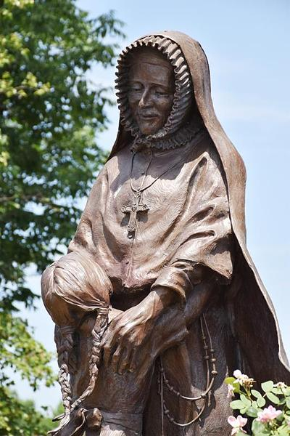
Arrival in Frontier Town, St. Charles
September 7 to October 3, 1818

Slide 2
Les Petites Cotes 1769
In 1769 Louis Blanchette, a French hunter and explorer, built a hunting and trapping headquarters at "the point where the first creek flowed from the first hills on the left bank" of the Missouri River above its junction with the Mississippi. Other cabins sprang up around Blanchette's cabin, and he called the settlement the Little Hills, "Les Petites Cotes.“
https://scchs.org/cpage.php?pt=24#General%20History
http://www.waymarking.com/waymarks/WM1QCH_Louis_Blanchette_St_Charles_Missouri

Slide 3
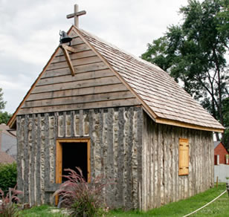
San Carlos Borromeo 1791
In 1791, Manual Perez, Spanish Lieutenant Governor of the Louisiana Territory, dedicated the village of "San Carlos Borromeo." The culture and language was predominately French, since most of the settlers were French-Canadian.
https://scchs.org/cpage.php?pt=24#General%20History
St. Charles Borromeo Log Church
http://www.borromeoparish.com/Old-Site/parishhistory.html

Slide 4
Daniel Boone Mid 1790’s
http://greatriverroad.com/stcharles/boonehome.htm
From the mid-1790s there was a wave of migrants from Kentucky and Tennessee settling in or passing through St. Charles County which included Daniel Boone. The Boone home, built by his son Nathan, in western St. Charles County still stands.
https://scchs.org/cpage.php?pt=24#General%20History

Slide 5
Lewis & Clark 1804
In May, 1804, immediately following the Louisiana Purchase, Lewis and Clark, beginning their famous expedition, visited this "village of about 100 houses and 450 inhabitants, chiefly French." Clark and crew, having come up the river to St. Charles on May 16, were joined here four days later by Lewis who had tarried in St. Louis to officiate at the ceremonial transfer of the territory to the United States. Before their return in September, 1806, the name had been anglicized to St. Charles and the United States had established here the third post office west of the Mississippi.
https://scchs.org/cpage.php?pt=24#General%20History
http://www.boodyfinearts.com/projects/stcharlesparks.html

Slide 6
September 7, 1818
The nuns ride in a carriage from the St. Louis riverfront to the banks of the Missouri River.

Slide 7
September 7, 1818:
They ferry across the Missouri River to
St. Charles.

Slide 8
September 7, 1818
Philippine and her four companions finally reach their destination!
“Divine Providence has brought us to the remotest village in the United States. It is situated on the Missouri, which is frequented only by those trading with the Indians who live not very far away from here, but I have not seen any little Indian girls since we came here.”
— Philippine Duchesne, RSCJ, in a letter to Mother Barat

Slide 9
September 8, 1818
Bishop DuBourg celebrates Mass in the “Duquette Mansion” then leaves for Portage des Sioux to install a new pastor there.

Slide 10
September 12, 1818
Bishop DuBourg returns to St. Louis after celebrating Mass again in St. Charles and installing Father Richard as pastor of the St. Charles Borromeo parish.

Slide 11
September 14, 1818
The first day of school for the little daughters of St. Charles residents.

Slide 12
September 20, 1818
On warm days some of the teaching takes place outdoors on the gallery of the “mansion.” More often classes are held indoors.

Slide 13
October 3, 1818
General Pratte keeps his promise and brings two of his daughters (Emilie and Therese) and their cousin Pelagie Chouteau to the Sacred Heart Academy in St. Charles. They will stay for eleven months.

Slide 14
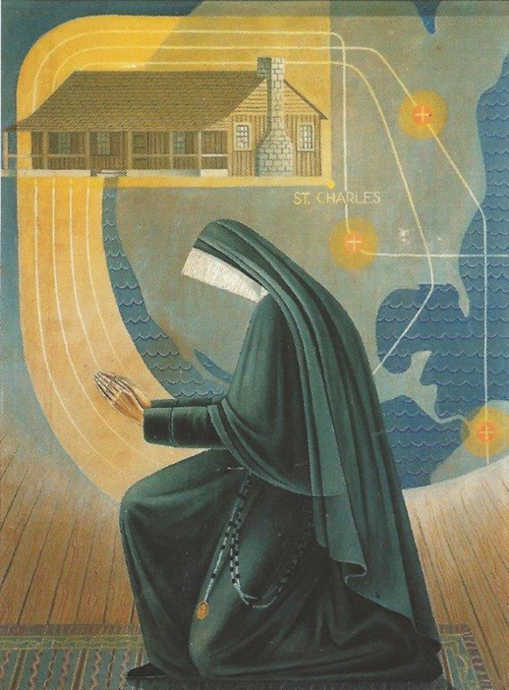
“To do Thy Will, O my God, is all my desire.”
-- Offertory, Votive Mass of the Sacred Heart

Slide 15
Callan, Louise. Philippine Duchesne: Frontier Missionary of the Sacred Heart Maryland:Newman, 1957, Print.

