Slide 1
Pioneer Philippine Lands in Saint Louis
August 22 to September 1, 1818

Slide 2
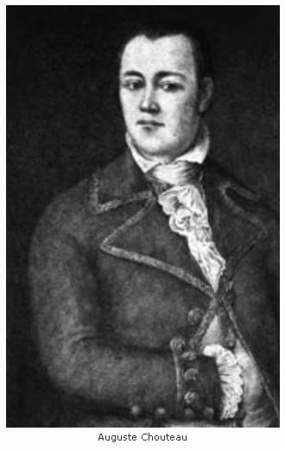
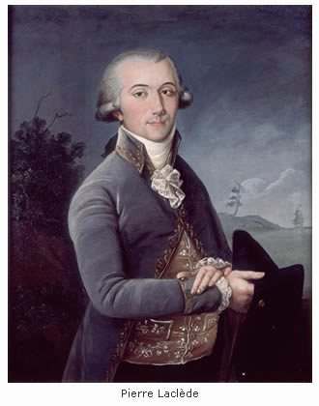
Co-Founders of St. Louis https://www.distilledhistory.com/category/colonialstlouis/

Slide 3
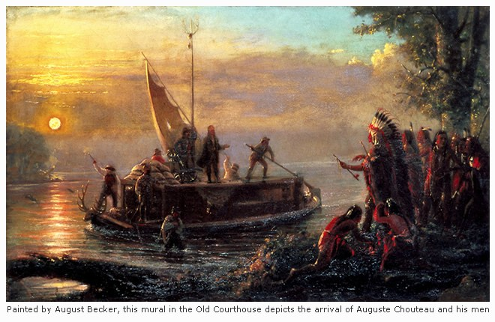
Saint Louis 1764
“On February 15, 1764, Auguste Chouteau pulled to shore at the head of his charge. As he instructed some of his men to begin clearing land the next morning, he instructed others to build necessary storehouses and living structures. Auguste Chouteau then began to plot out Laclede’s proposed street grid on the same land that now sits beneath the Gateway Arch. That day, February 15, 1764, is the moment the city of St. Louis came to be.” ”
https://www.distilledhistory.com/category/colonialstlouis/

Slide 4
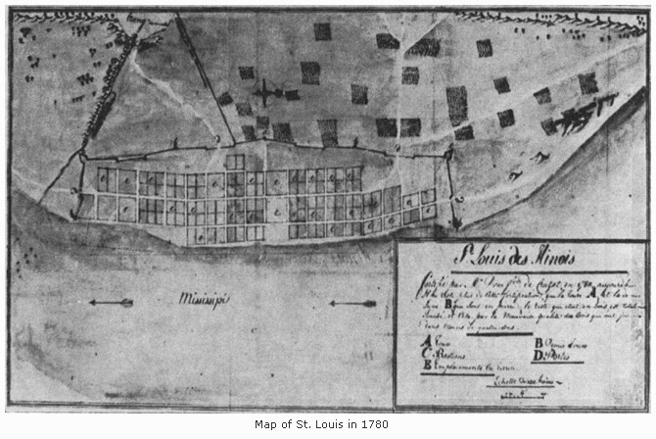
Saint Louis 1780
https://www.distilledhistory.com/category/colonialstlouis/

Slide 5
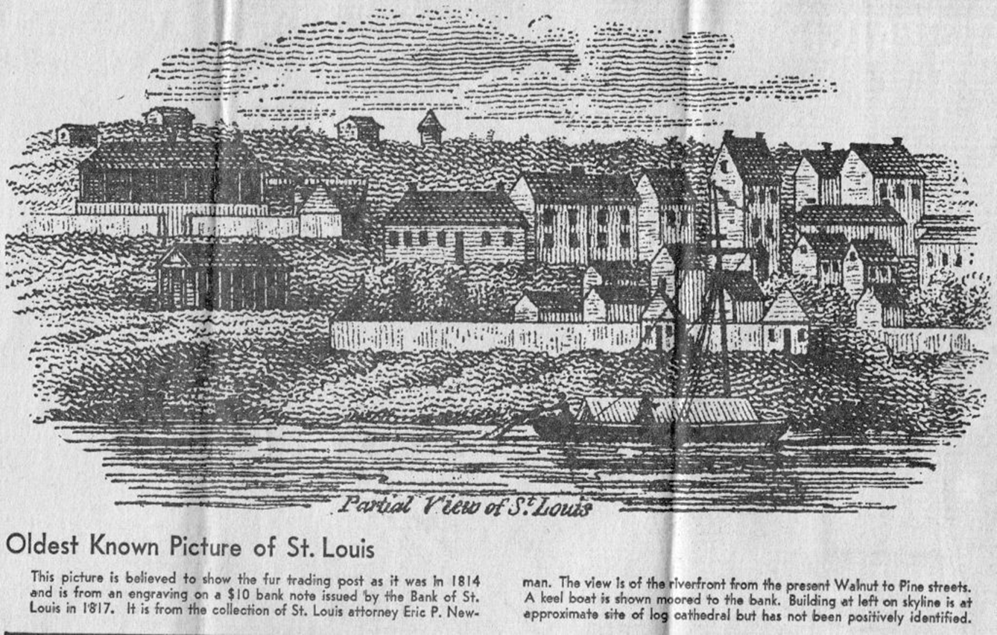
“These images were published in the Sunday edition of the St. Louis Post-Dispatch, February 16, 1964, to commemorate the 200th anniversary of the founding of St. Louis by Pierre Laclede and August Chouteau. Represented are some very common names is today's St. Louis: Pratte, Berthold, Smith, Lisa, Labadie, Papin, Clark, Gratiot, McKnight, and Brady.
This newspaper article came from a collection given to me by Marguerite Boulicault Foster who lives in San Antonio, Texas. When she and her husband moved from St. Louis her Uncle Willis saved everything he could about St. Louis to send to her to keep informed on things happening in her home town. Thanks Marguerite.” https://stlouis.genealogyvillage.com/oldest.htm

Slide 6
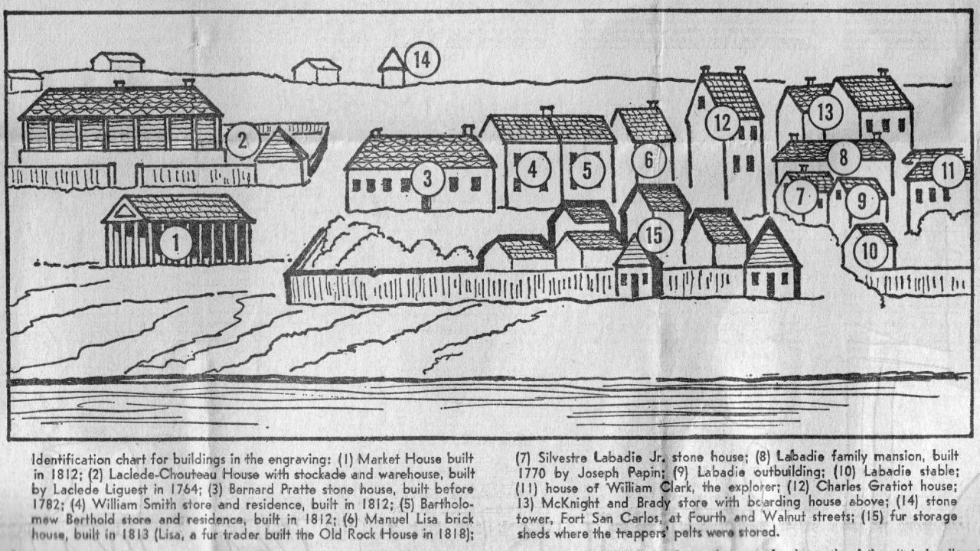
Identification Chart for Buildings in the Previous Engraving
https://stlouis.genealogyvillage.com/oldest.htm

Slide 7
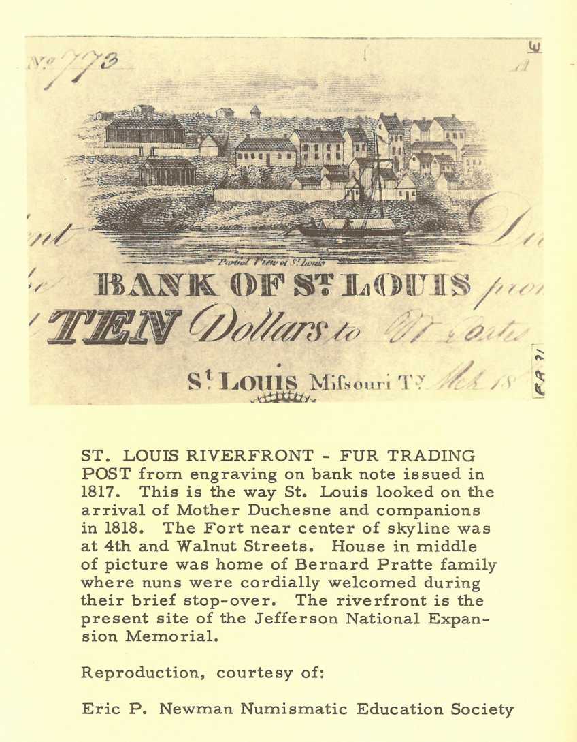
1817

Slide 8
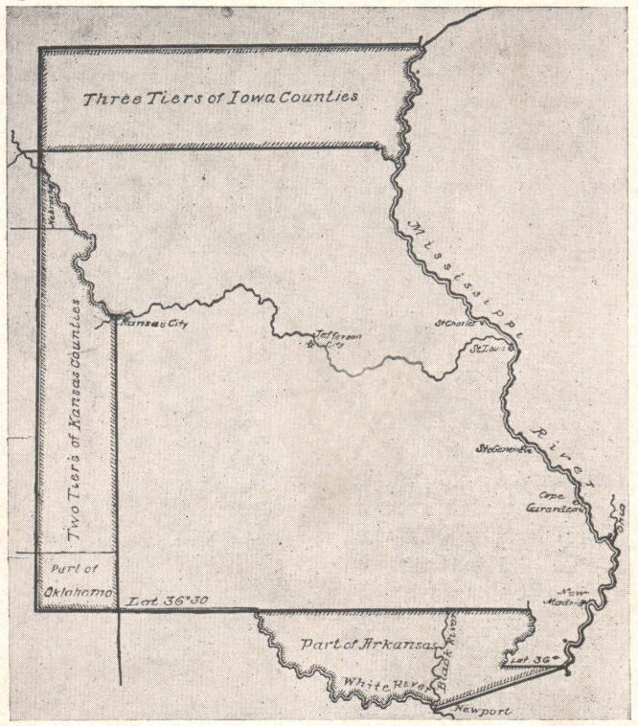
August 21, 1818
By 1818 the population of the area of which St. Louis was the chief town totaled more than sixty-five thousand and raised a national crisis when Missouri asked admission to the Union as a state in which slavery was allowed by law.
All this the nuns on board the Franklin had learned when the steamboat anchored for the night a mile below the foot of the Market Street landing on the evening of August 21, the feast of St. Jane Frances de Chantal.
The boat had been expected for several days and its cargo of merchandise had been advertised in the Missouri Gazette that very day, but the presence of the nuns on board was not presented as a news item.
Map: http://www.osagecounty.org/Maps/map1818.html

Slide 9
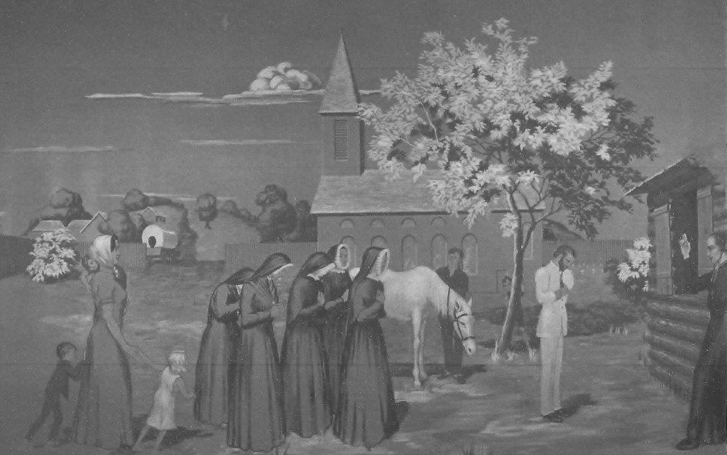
August 21, 1818
The nuns are welcomed to St. Louis by Bishop DuBourg and invited to stay at the home of General and Mrs. Bernard Pratte, who are parents of two sons and five daughters.

Slide 10
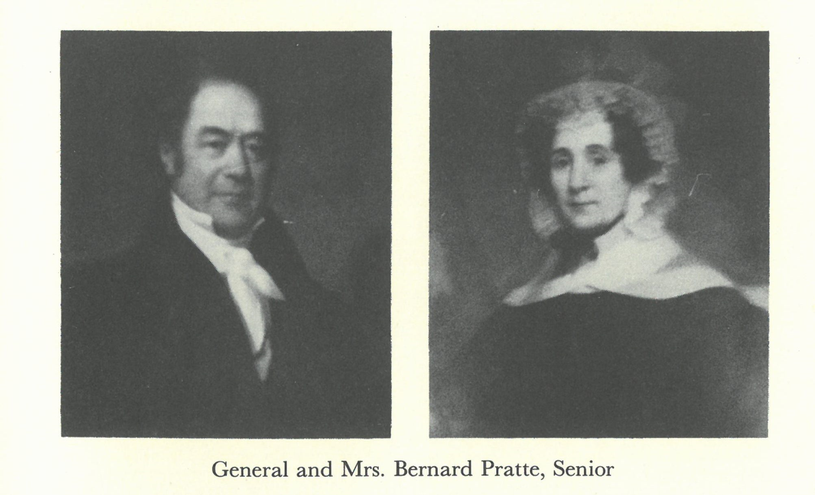
General Bernard Pratte
General Bernard Pratte and his wife gave hospitality to these first nuns who ever crossed a threshold in St. Louis. Their home stood at the corner of Main and Market Streets, a French colonial structure of the best frontier type, built of upright posts set on a stone foundation, two stories high, with a gallery extending around the four sides. There was the usual detached kitchen to the rear, and a roomy garden and orchard were neatly fenced in. Bernard Pratte and his wife had lived there since 1797.

Slide 11
St. Louis Hospitality
So Mother Duchesne and her companions were welcomed to the newly renovated home, and there they remained for three weeks in the midst of kindness and consideration that rivaled even the charity of the Ursulines.
The Prattes were a happy French Catholic family, presided over by a charming Creole mother, who had been Emilie Labbadie, and including two sons and five daughters.
They were related to “almost everybody in town,” as their maternal grandmother was Pelagie Chouteau, sister of the co-founder of St. Louis, and intermarriage had been frequent among the best Creole group in town.

Slide 12
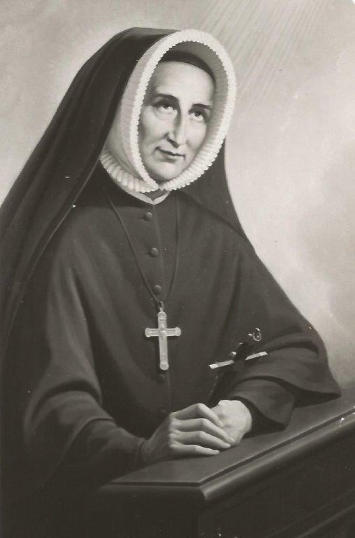
August 22, 1818
Mother Duchesne writing to her Superior General on the night of August 22:
“We had our hearts set on St. Louis, and it turns out to be another camping place. We are lodged in a comfortable home, where we are getting acquainted with the children who will be the first pupils in our boarding school. In a week we shall leave for St. Charles, where we are to begin our work in a rented house.”
Bishop DuBourg “regrets that he cannot keep us in St. Louis, but there is not a single room for rent in the town. He puts before us the great advantages St. Charles possesses. He thinks it will become one of the most important cities of North American, as it is situated on the Missouri River, along which the population is growing daily and which is about to give its name to a new state of the Union. No day passes without the arrival of four or five families with their belongings, who come to settle in a country which is making astonishing progress.”

Slide 13
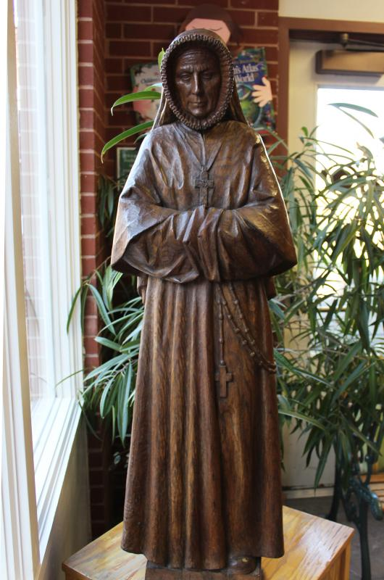
Obedience
St. Charles had been decided on, long before the nuns reached St. Louis, and after their arrival the Bishop gave no serious consideration to any alternative.
He listened to the arguments, suggestions, and generous offers of General Pratte, who doubted the wisdom of placing the nuns in an outlying district and was willing to put at their disposal a house in St. Louis.
He admitted the need for an educational institution in the town and the desire which many prominent Catholics had expressed with regard to the Religious of the Sacred Heart.
Yet he held to his first decision, and Mother Duchesne knew that soon she would have to say goodbye to St. Louis.

Slide 14
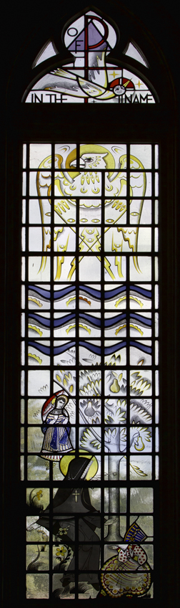
Future Students
Mr. Pratte is going to entrust to us his five daughters in succession.
His wife is the most highly esteemed person in the city. Her five little girls, though dreadfully spoiled, have taken such a fancy to us that they want to come to our school, wherever it may be.
In season and out of season Celeste torments her parents at least four or five times a day to send her to school sooner than they planned.
A great number of their cousins, all delightfully well-mannered, have come to see us and want to be our pupils. One of them could not sleep for joy the night we arrived.
Emilie and Therese Pratte had obtained their father’s solemn promise that they would be the first pupils of the boarding school, once Mother Duchesne and her companions were settled in their new home.

Slide 15
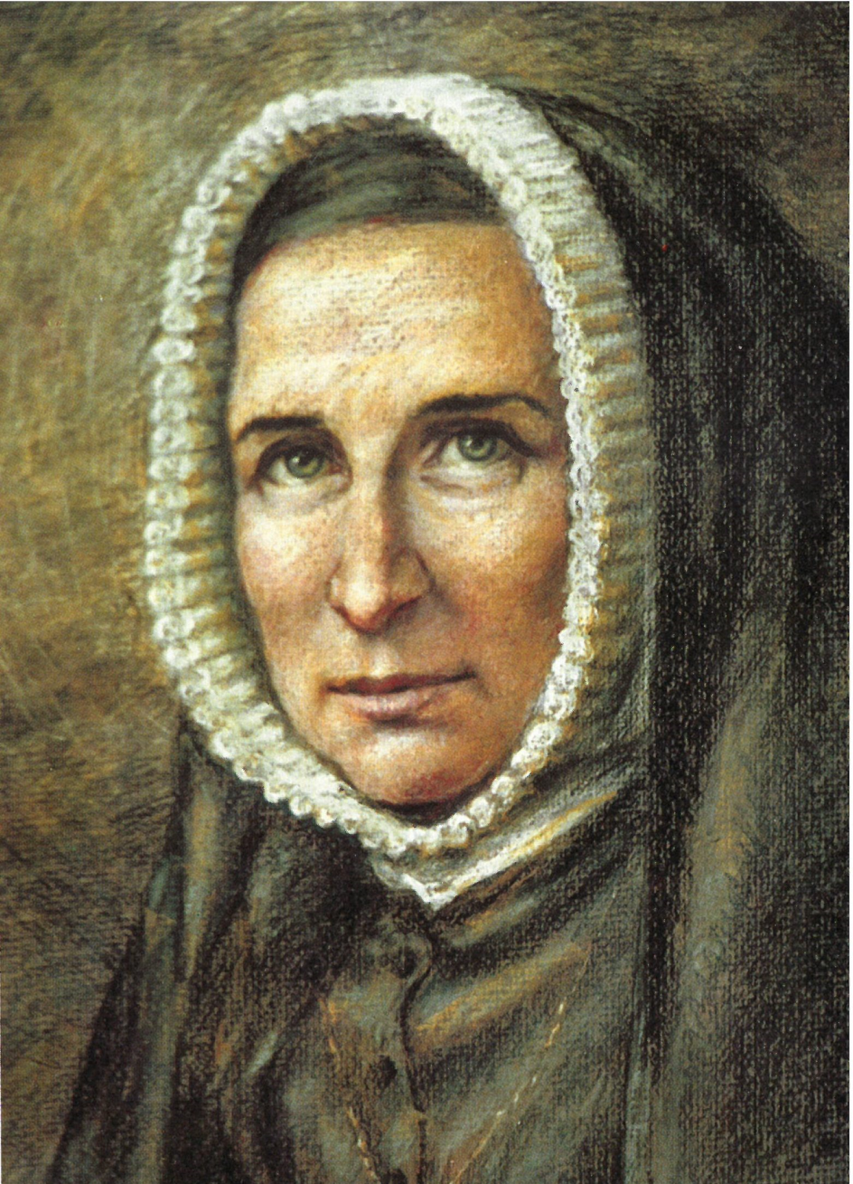
August 29, 1818
Philippine marks her forty-ninth birthday.

Slide 16
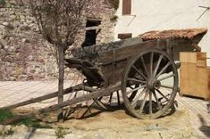
Packing Again
September 1, 1818: The nuns pack their bags again after a seventeen-day stay with the Prattes in St. Louis.
The General reluctantly ordered a charette for the baggage, a carriage for the nuns, and saddle horses for the Bishop and Father Richard, to be ready early on Monday morning, September 7.

Slide 17
What if Philippine Stayed in St. Louis?
The if’s of history furnish fascinating material for speculation. If General Pratte had had his way, the American life-story of Philippine Duchesne might have been quite different in many respects from the tale of struggle with poverty, anxiety, hardship, isolation, and suffering that stamped her thirty-four years on the frontier.

Slide 18
Callan, Louise. Philippine Duchesne: Frontier Missionary of the Sacred Heart. Maryland:Newman, 1957. Print.

