Slide 1
Philippine’s Packing List
In 1817, what does one pack to travel across the Atlantic Ocean, up the Mississippi River to
St. Louis, and ultimately to St. Charles to open a school and fulfill a lifelong dream?

Slide 2
Let’s Find Out Using Philippine’s Letters
“In an August 29, 1817 letter from Philippine to her cousin, Josephine, about her upcoming journey to the New World: “So we must prepare what is needed for a sacristy.””
(Callan, p. 200)
(See Common Resources, “Truly a Treasure” for the history behind Philippine’s ciborium at right.)

Slide 3
Vestments
“Furthermore, the vicar-general [of Bishop Du Bourg], who is remaining at Bordeaux as agent for the mission, writes to our Mother General, begging her to procure material, muslin, linen, galloon, all that can be used to make vestments and all that can impress the savages in the pomp of liturgical ceremonies.”
(Callan, p. 200)

Slide 4
School Books
“Preparations for the voyage were, however, under way. News of the Superior General’s promise to Bishop Du Bourg has traveled to Amiens, Poitiers, Grenoble, Niort, and Quimper. In all the convents contributions for the mission were being collected and packed for shipment.”
(Callan, p. 203)

Slide 5
Packing….
“She packed the trunks, cases, satchels, without the least anxiety or trouble.”
(Callan, p. 204)

Slide 6
Passports
“The passports gave most anxiety, for it was feared they would not be obtained in time. But a relative of Mother Duchesne took the matter in hand, battled with the difficulties, and brought the papers a few hours before the party left us.”
(Callan, p. 204)

Slide 7
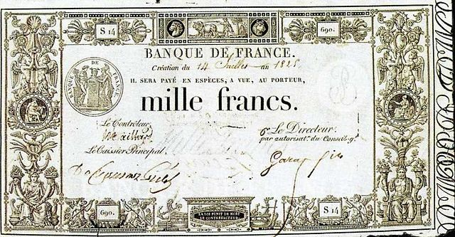
Notes and Bills of Exchange
“The menfolk, too, were busy with notes and bills of exchange amounting to nearly 20,000 francs—their own money or Philippine’s—to finance the missionary venture of this middle-aged cousin whom they loved so sincerely.”
(Callan, p. 204)

Slide 8
I must collect as much as possible.
“In a January 24, 1818 letter from Philippine to her Cousin Josephine: ‘My brother sent me a note for 7000 francs, which I am not eager to cash until there is an actual need. But I do not want the several sums of money to be decreased by the rate of exchange or by delay. The religious who are going with me have nothing to contribute except their good will. The Bishop warned us not to count on him for financial aid. The expense of the voyage and the necessity of providing a dwelling place will use up all the money. That is why I must collect as much as possible.’”
(Callan, p. 205)

Slide 9
Seeds of All Kind
“In a February 1, 1818 letter to her sisters Philippine writes: ‘I wish you would send me a supply of seed of all kinds you have, labeled and marked with the time for sowing. The land is so fertile in the area where we shall live that the cattle are entirely hidden in the prairie grass.’”
(Callan, p. 207)

Slide 10
Pack the Wagon
“February 8, 1818: ‘A crowd of curious onlookers gathered around the stagecoach before the nuns climbed in with their satchels and packages. The trunks and packing cases had gone ahead in a wagon.’“
(Callan, p. 211)

Slide 11
To Quench Thirst
“February 15, 1818 Philippine writes to her family from Bordeaux: ‘Monsieur Morange has been so thoughtful as to supply us with wine for the sea voyage.’ ‘After waiting several days I had the pleasure of greeting Madame Morange and Mademoiselle Emiline. They are wonderfully kind. I have never had a more cordial welcome. They are going to supply us with preserves and apples—they say apples are the best fruit to quench thirst.’”
(Callan, p. 216)

Slide 12
Religious Relics
“February 18, 1818 Philippine writes to Mother Barat: ‘I have been to the home of Madame Fournier, Bishop Du Bourg’s sister.’ ‘She has reserved our sleeping quarters on shipboard and is now talking about comforts, that is, things to take with us for the sake of the body—mostly food. As to the wine, Monsieur Morange has kindly taken care of that.’ ‘Father Boyer paid us a long visit yesterday, showing great interest and speaking of the consolation we shall enjoy. He is going to give me some relics.’”
(Callan, p. 217)

Slide 13
Reliquary of the True Cross
“Our furnishings arrived in good condition. Monseigneur was very well pleased with all the chapel equipment. The statue of our Lady over the tabernacle touches the ceiling of our tiny chapel, which is about the size of the sanctuary of our chapel in Paris, but all is very devotional in this little corner. There is a beautiful picture of the Sacred Heart with more than fifty figures. This came from Rome. The picture of our Lord showing His Sacred Heart is also from the Eternal City. The paintings of the Nativity and of the Adoration of the Magi are ravishing. There is a reliquary containing small fragments of the True Cross…relics of many saints, including St. Ignatius and St. Francis Regis—more, all told, than you have, and finally that picture of St. Regis which I found in the garret of the church in Grenoble, and which I promised to have honored if he should bring us to America. We placed it above the tabernacle the day it was framed, and the Mass in honor of St. Regis was said.”
(Callan, p. 278-279)

Slide 14
Final Preparations in Bordeaux
Philippine’s February 28, 1818 Letter to Mother Barat:
Our diverse little shopping list: Trunks for the cabins, umbrella, alarm clock
Bedding includes a mattress, pillow, two blankets, and a mosquito net costing 144 francs each
Our places on the ship will cost 900 francs each
The food will be of good quality; there are live chickens, milk they have learned to preserve by a secret formula
Mr. Marange has offered a supply of wine

Slide 15
Callan, Louise. Philippine Duchesne: Frontier Missionary of the Sacred Heart. Maryland:Newman, 1957. Print.
In addition, the Academy of the Sacred Heart and the Shrine of St. Philippine Duchesne have the following items in the museum rooms that Philippine brought with her from France but are not mentioned in her letters.

Slide 16
Crucifix
Philippine brought this crucifix from France which she used in the infirmary.

Slide 17
Loretto Bell
A little Loretto bell used by Philippine when answering the prayers at Mass.

Slide 18
Philippine’s Side Beads
Side beads, worn by many orders of religious men and women, originally replaced the sword (worn by men in the days when many of these religious orders were founded.) Since most people were right-handed, the sword or side beads were worn on the left side.

Slide 19
Philippine’s Watch

Slide 20
Silver Spoons
Silver spoons brought from France for the infirmary – the spoon with the worn edge was used to cut hosts.

Slide 21
More Books

Slide 22
Using what we know about Philippine’s story,
what other items would Philippine have packed?

Slide 23
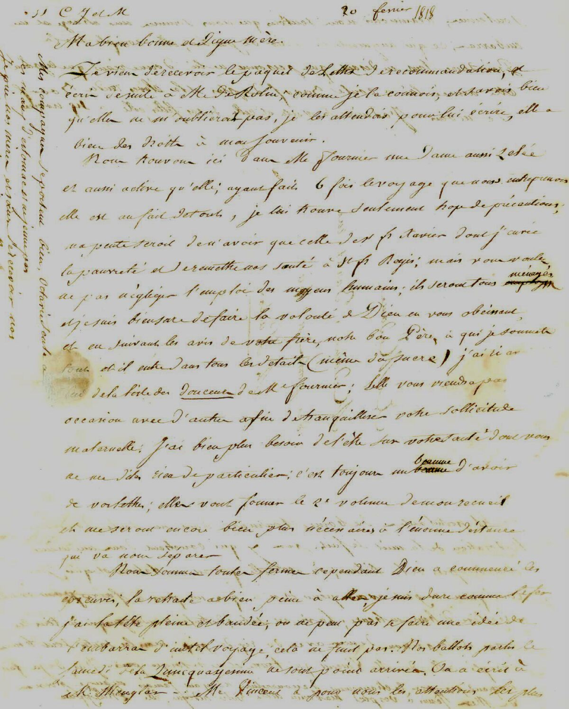
Paper, Quill & Ink

Slide 24
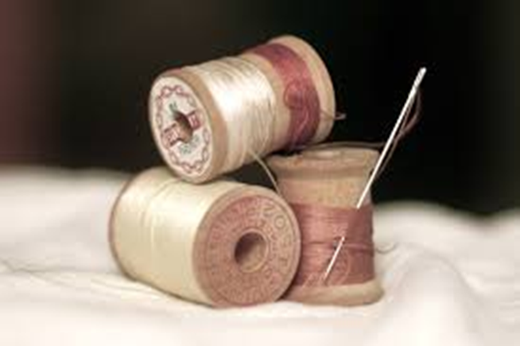
Religious Habit, Fabric, Needles and Thread to make and mend her religious habit.

Slide 25
Brainstorm….
What else do you think Philippine would have packed?

