Slide 1
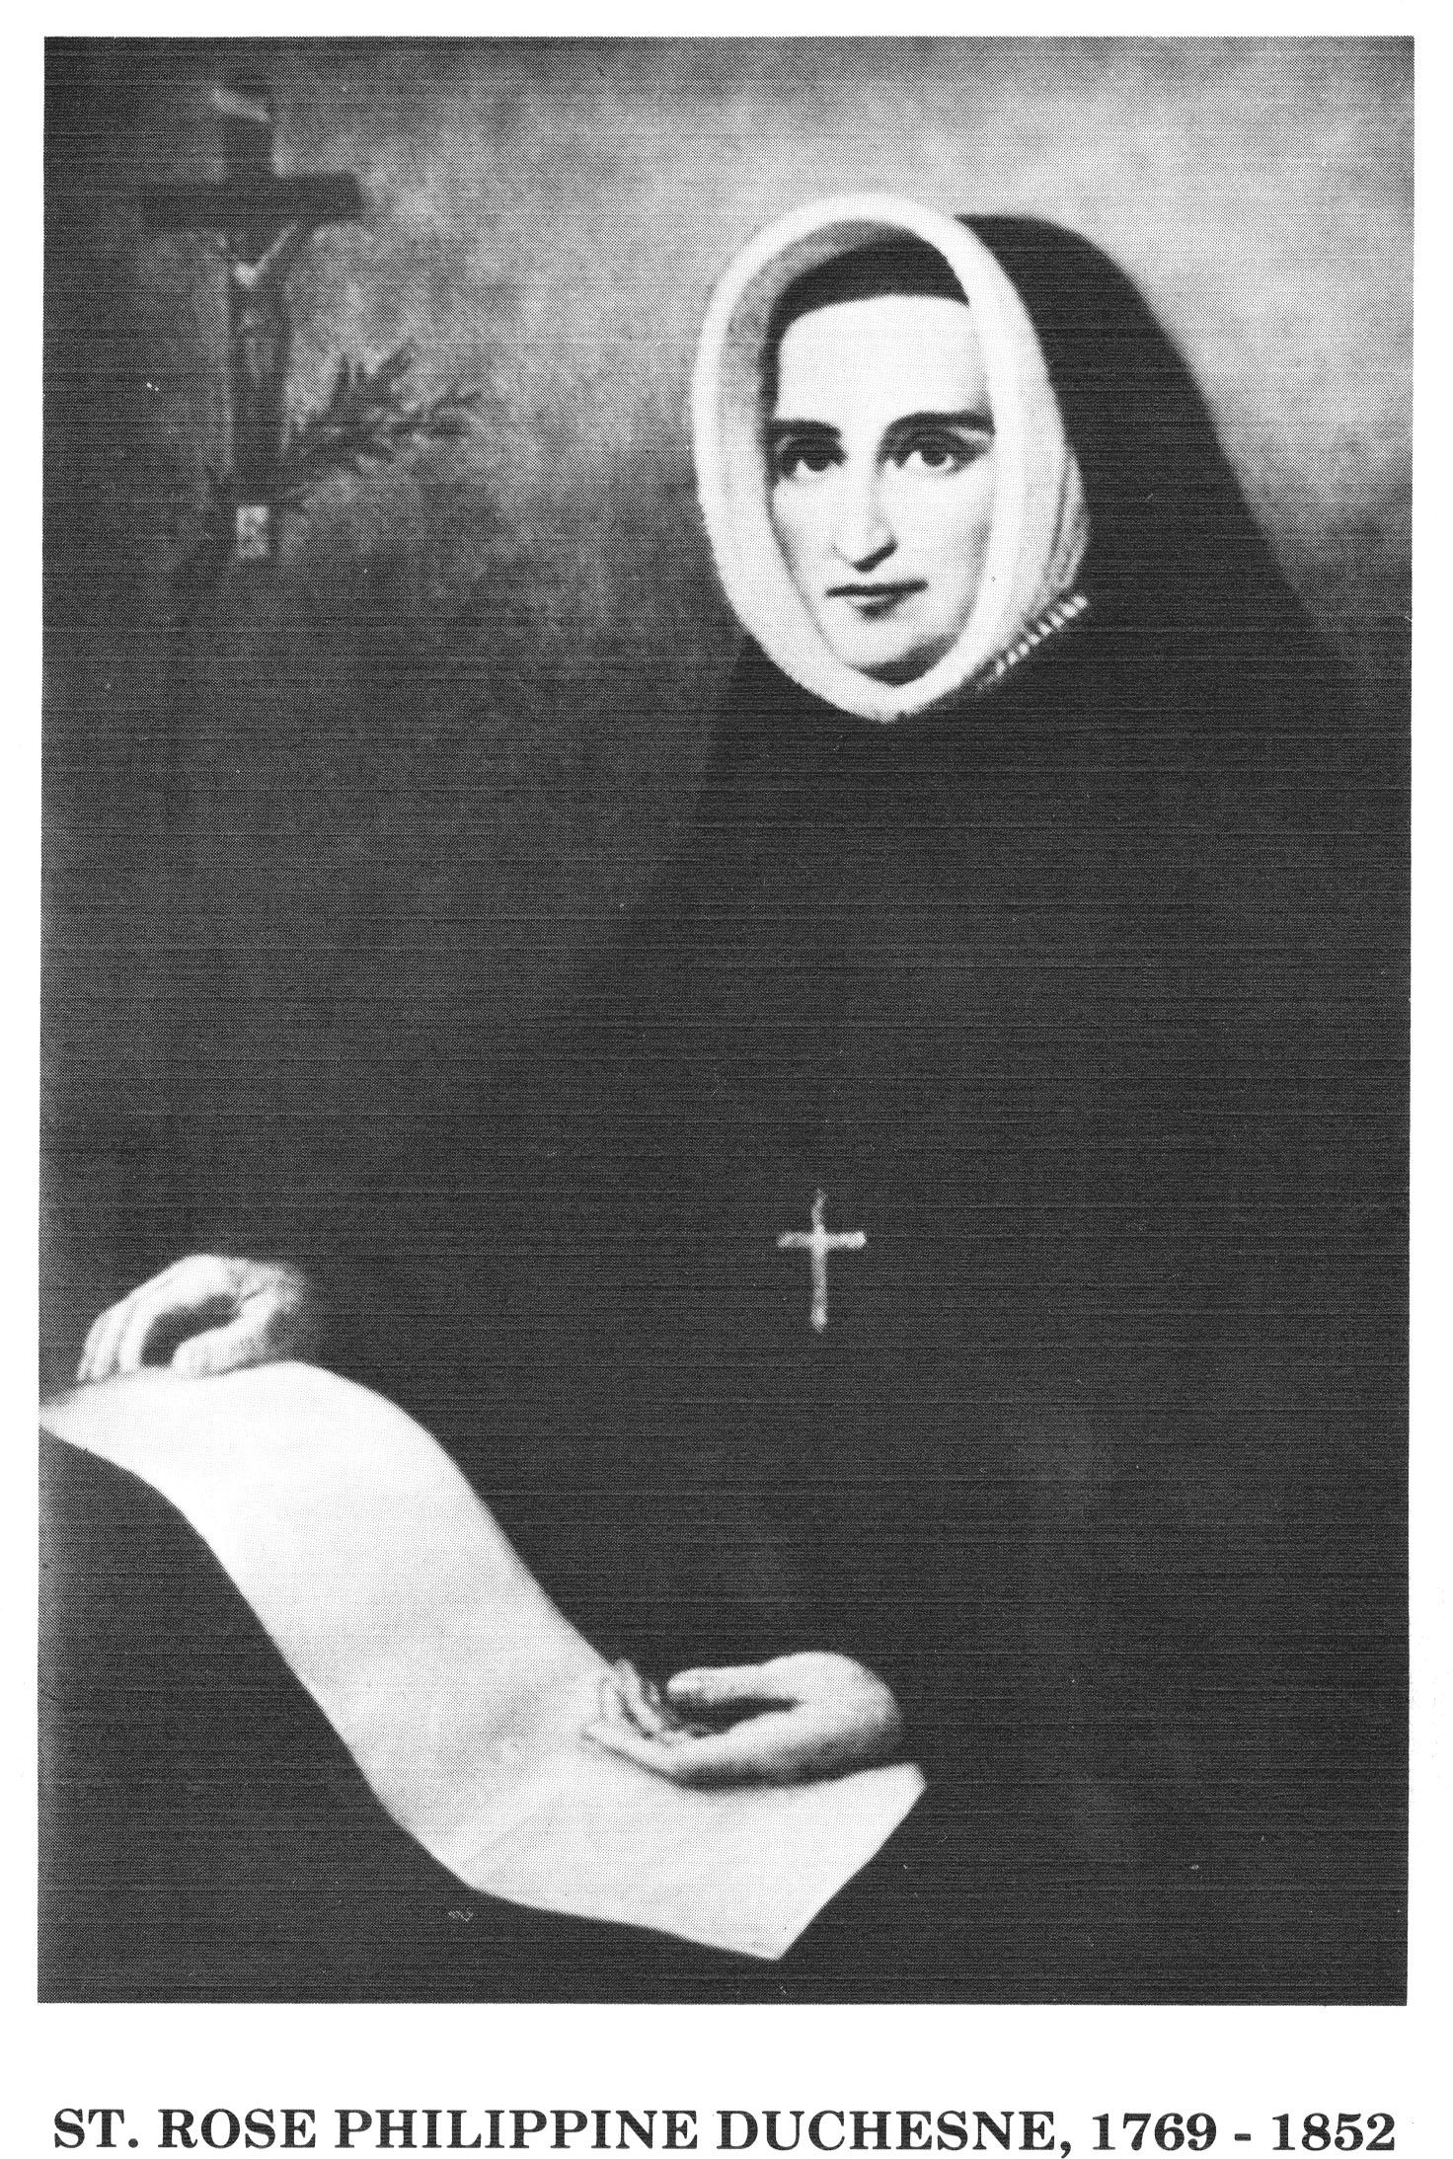

Slide 2
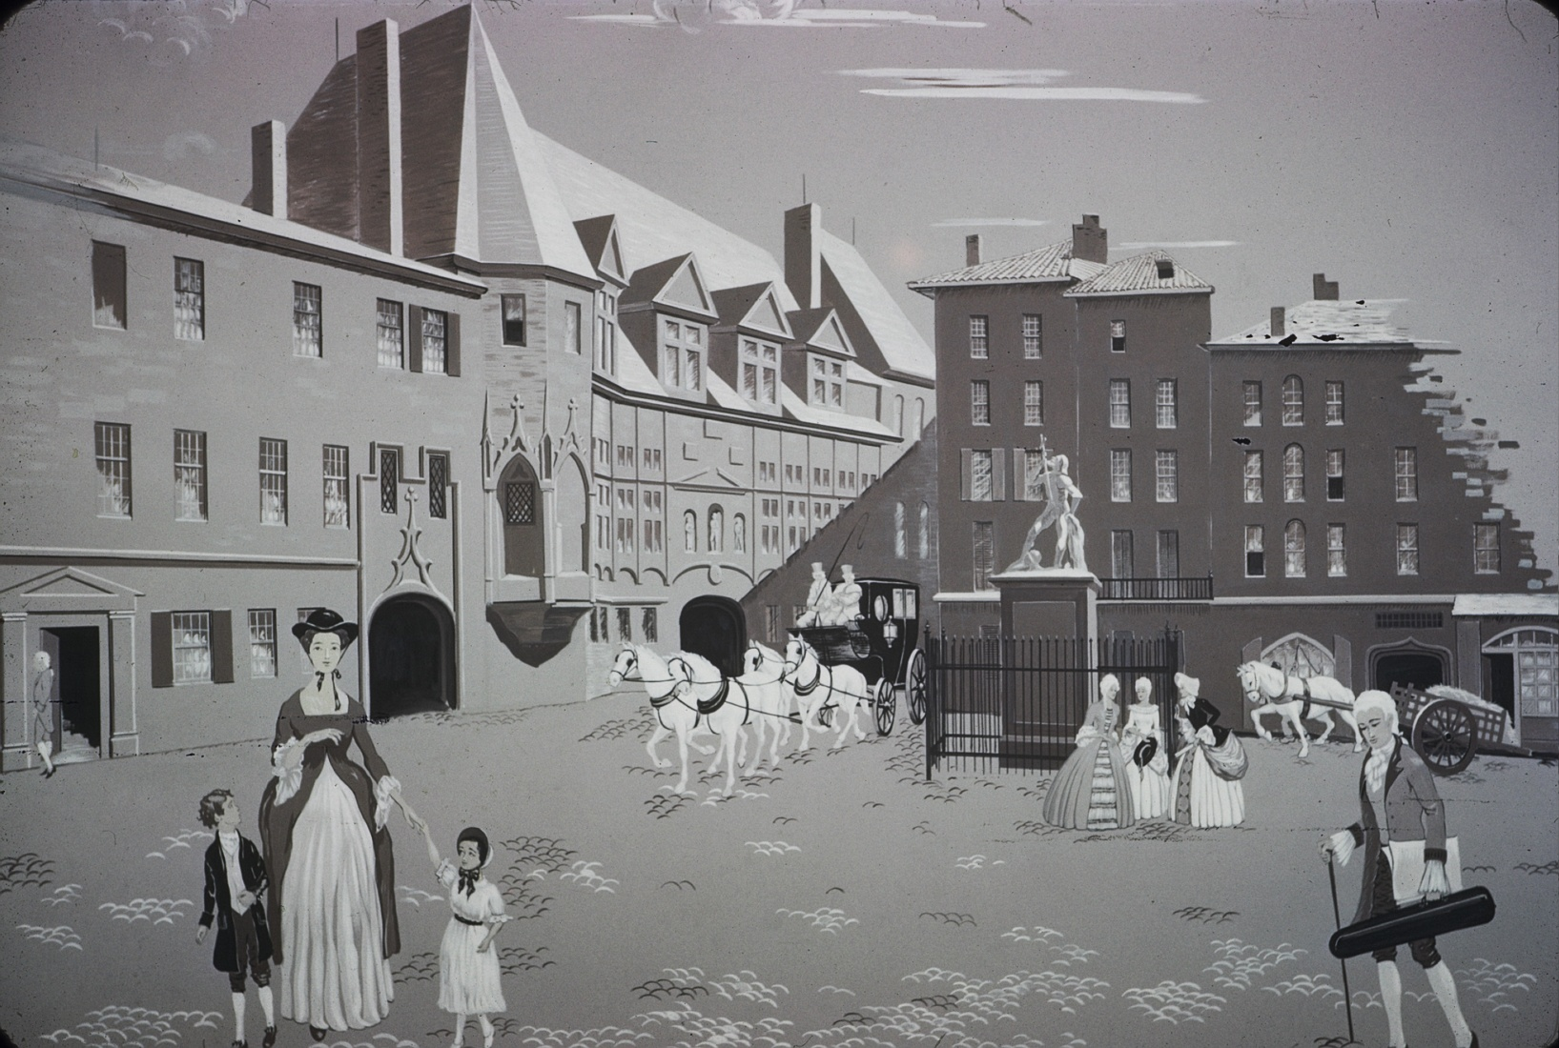
Philippine Duchesne was born in Grenoble, France, on August 29, 1769.
She was born into a large, wealthy family and enjoyed growing up with her sisters and brother. The Duchesne children lived next door to their Perier cousins.

Slide 3
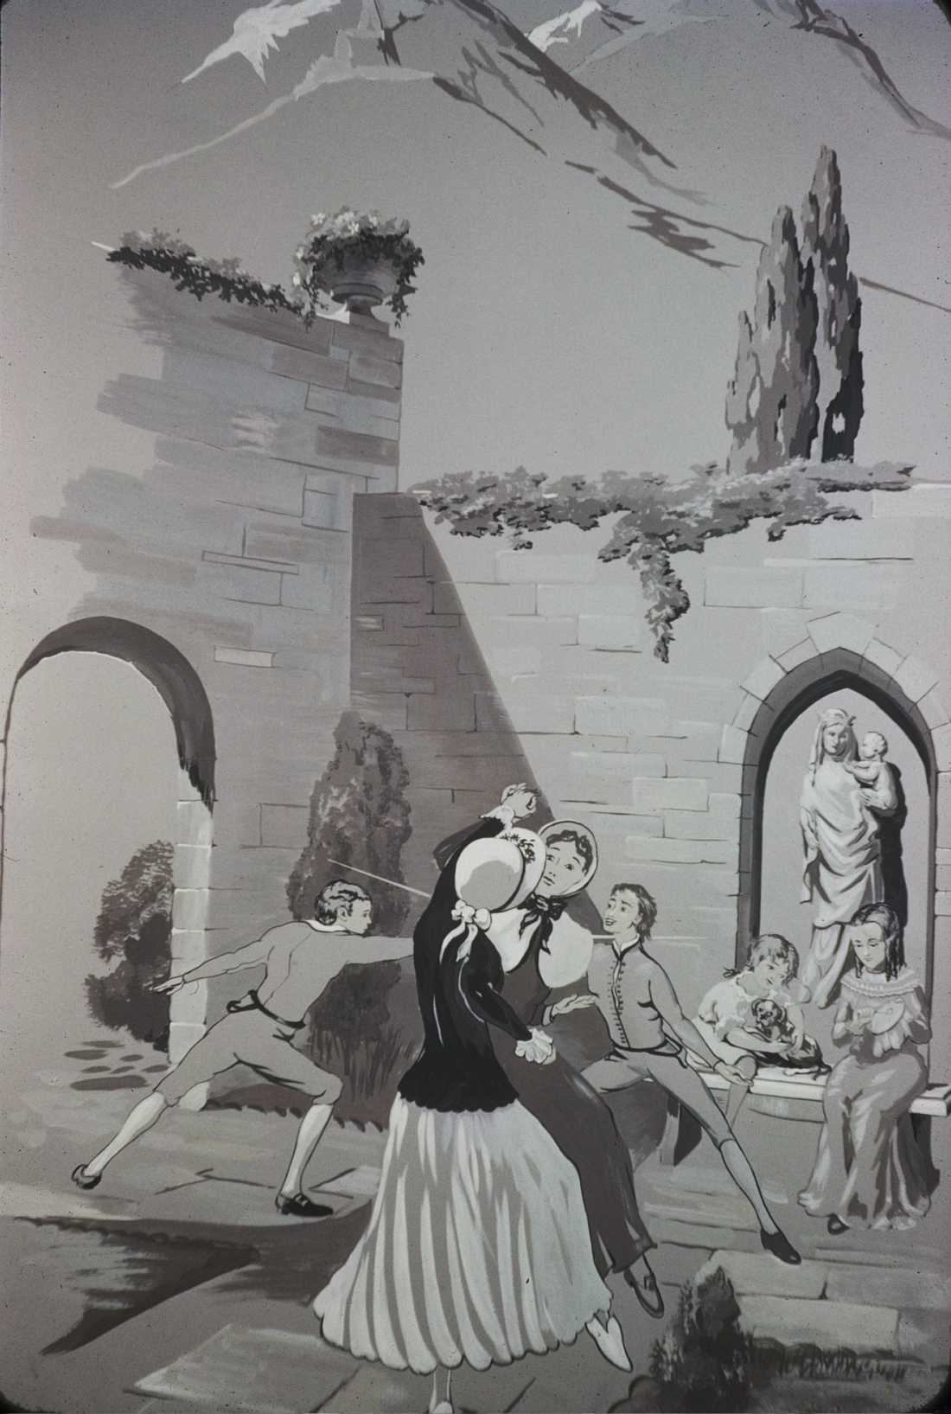
The children spent many happy hours playing in the courtyard that joined their homes.

Slide 4
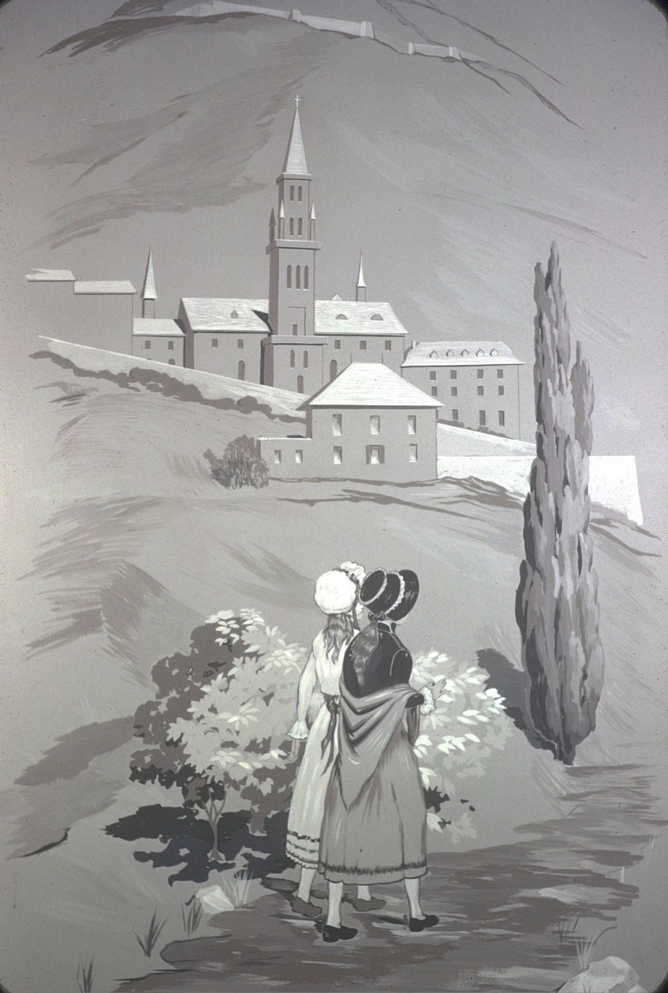
Philippine and her cousin, Josephine Perier, were constant companions. They loved to take walks up to the Visitation convent, Ste. Marie d’En Haut, which was on a hill overlooking Grenoble.

Slide 5
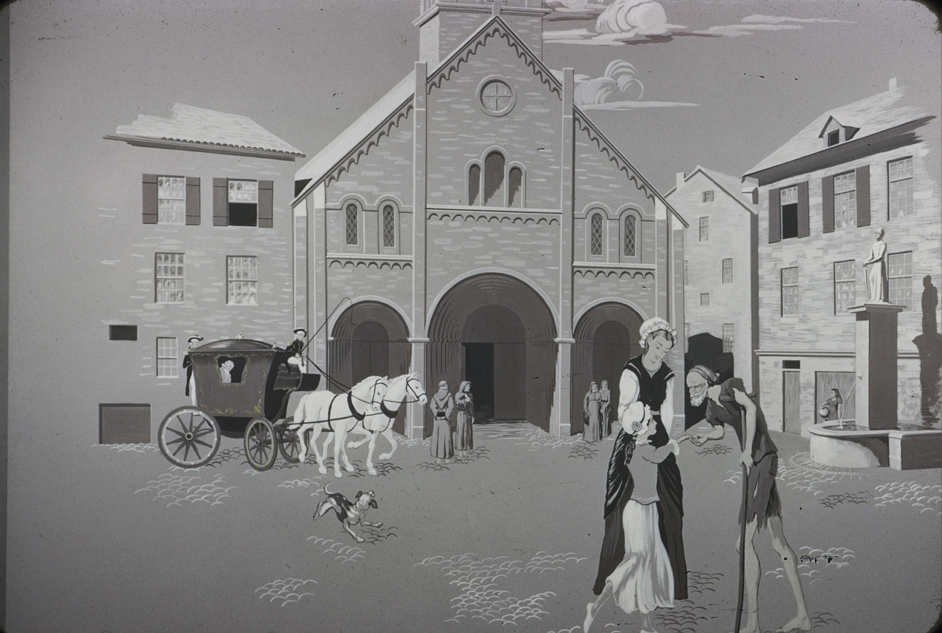
Beggars in the crowded square were often rewarded with a coin from the Duchesne and Perier children. One day, when Philippine was giving away her allowance, her mother said, “We give you that for your pleasure.” “This is my pleasure,” Philippine replied.

Slide 6
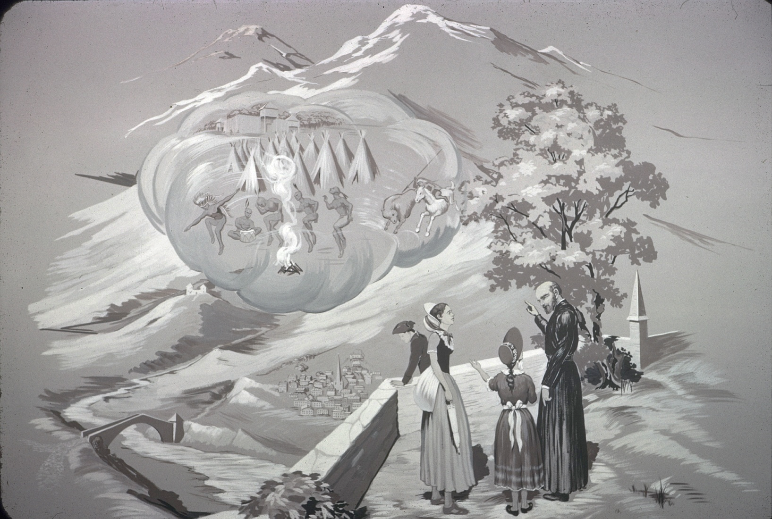
Occasionally, Philippine and Josephine met missionary priests who told about the Native Americans who needed to be taught about God. They were about eight years old when they first heard these exciting tales, and Philippine hoped to be a missionary herself one day.

Slide 7
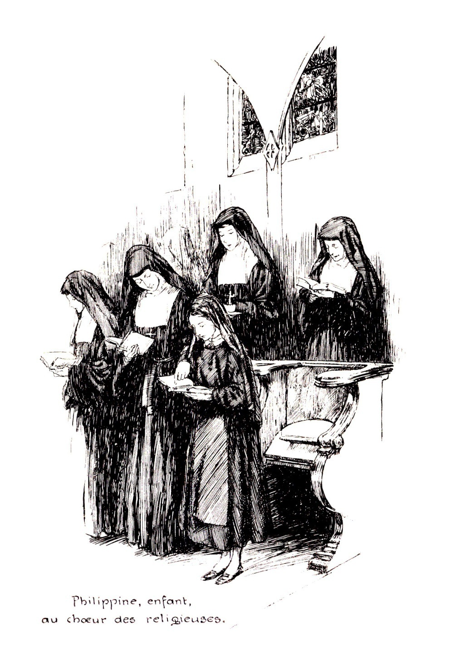
Philippine and Josephine went to Ste. Marie to prepare for their First Communion when they were 12 years old. This is when Philippine decided that she wanted to become a Visitation nun.

Slide 8
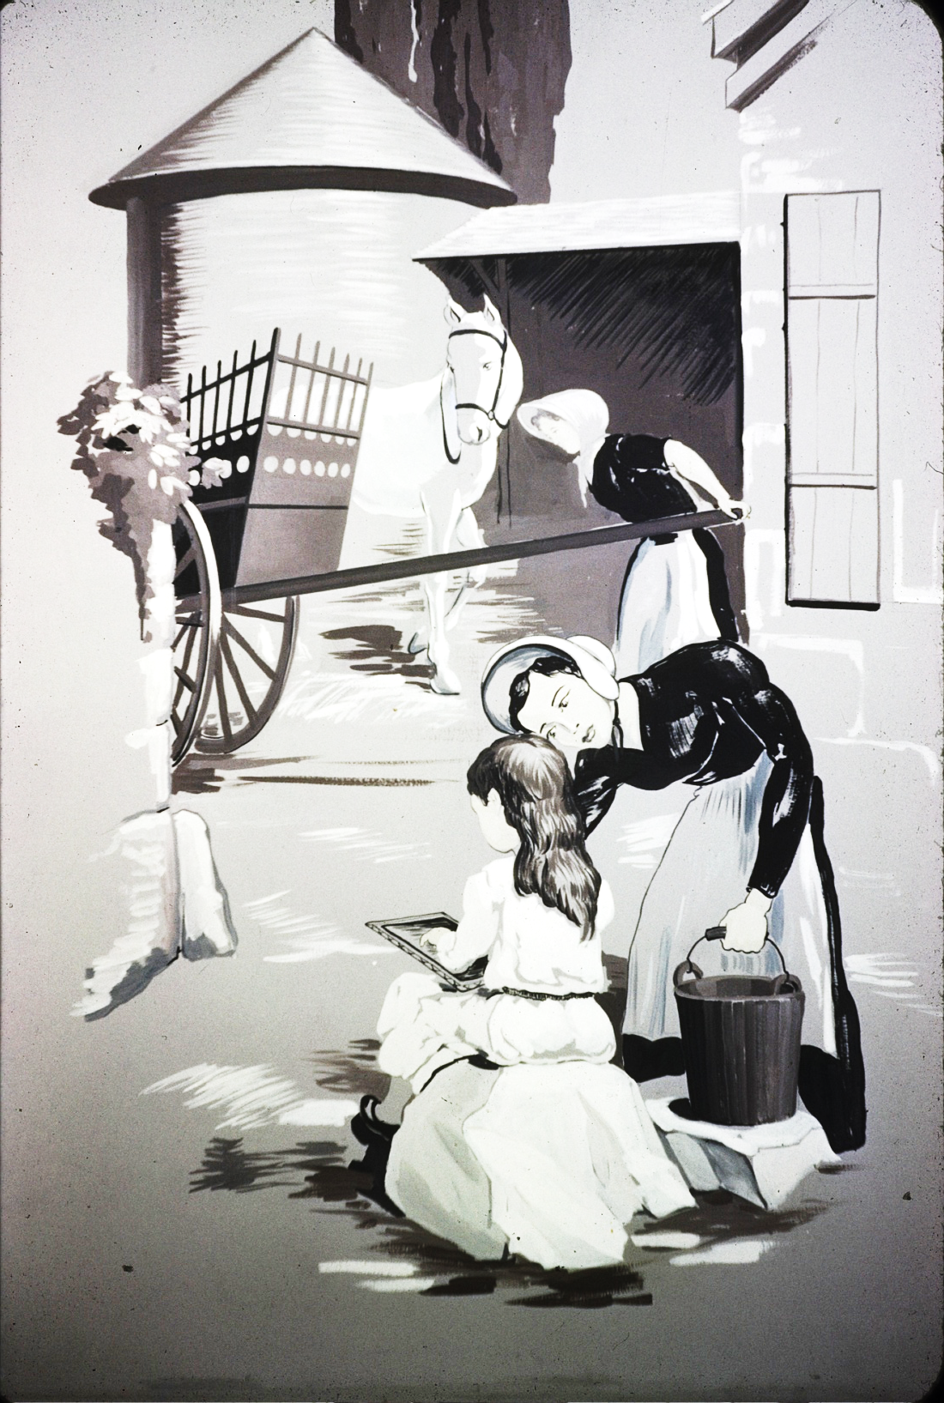
When her father realized his daughter’s intention of entering the religious life, he brought her home from the school at Ste. Marie. She played with her siblings and cousins and especially cared for her baby sister, Melanie.

Slide 9
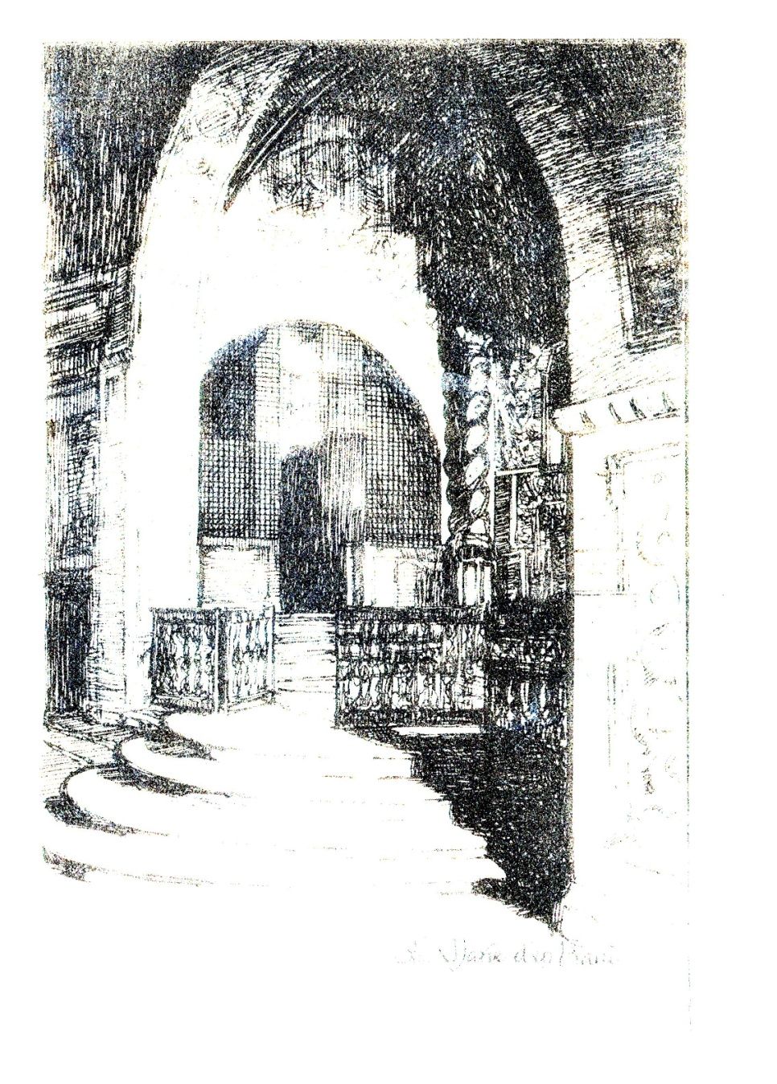
A few years later, Philippine and her Tante Perier climbed the steep hill to Ste. Marie. When they reached the convent, Philippine announced that she was staying! She remained there for four and a half years until convents were closed during the French Revolution.

Slide 10
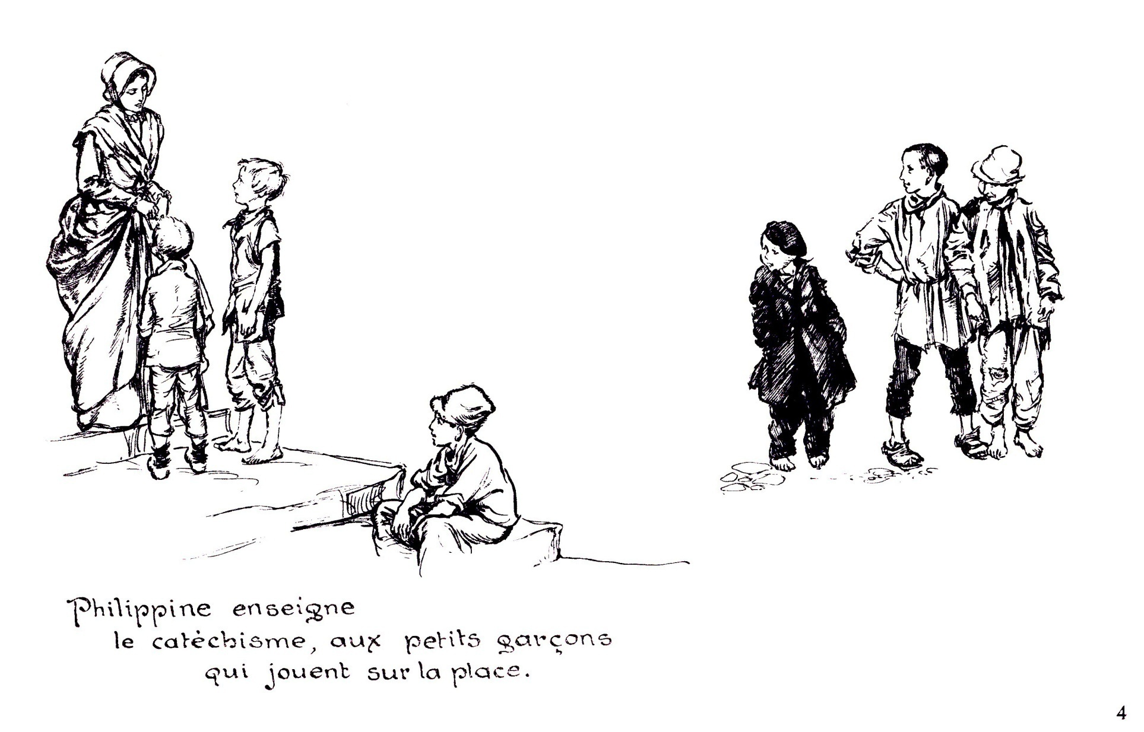
Philippine moved back to Grenoble and embraced a life of Christian service. She cared for the sick and taught children the catechism.

Slide 11
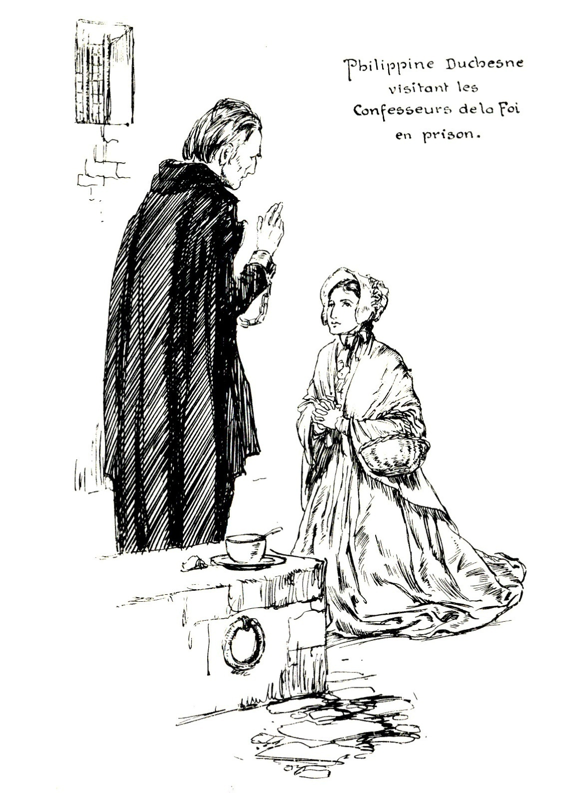
During the Revolution, many priests were in prison for refusing to renounce their faith, and Philippine would visit them often, although it was dangerous to do so.

Slide 12
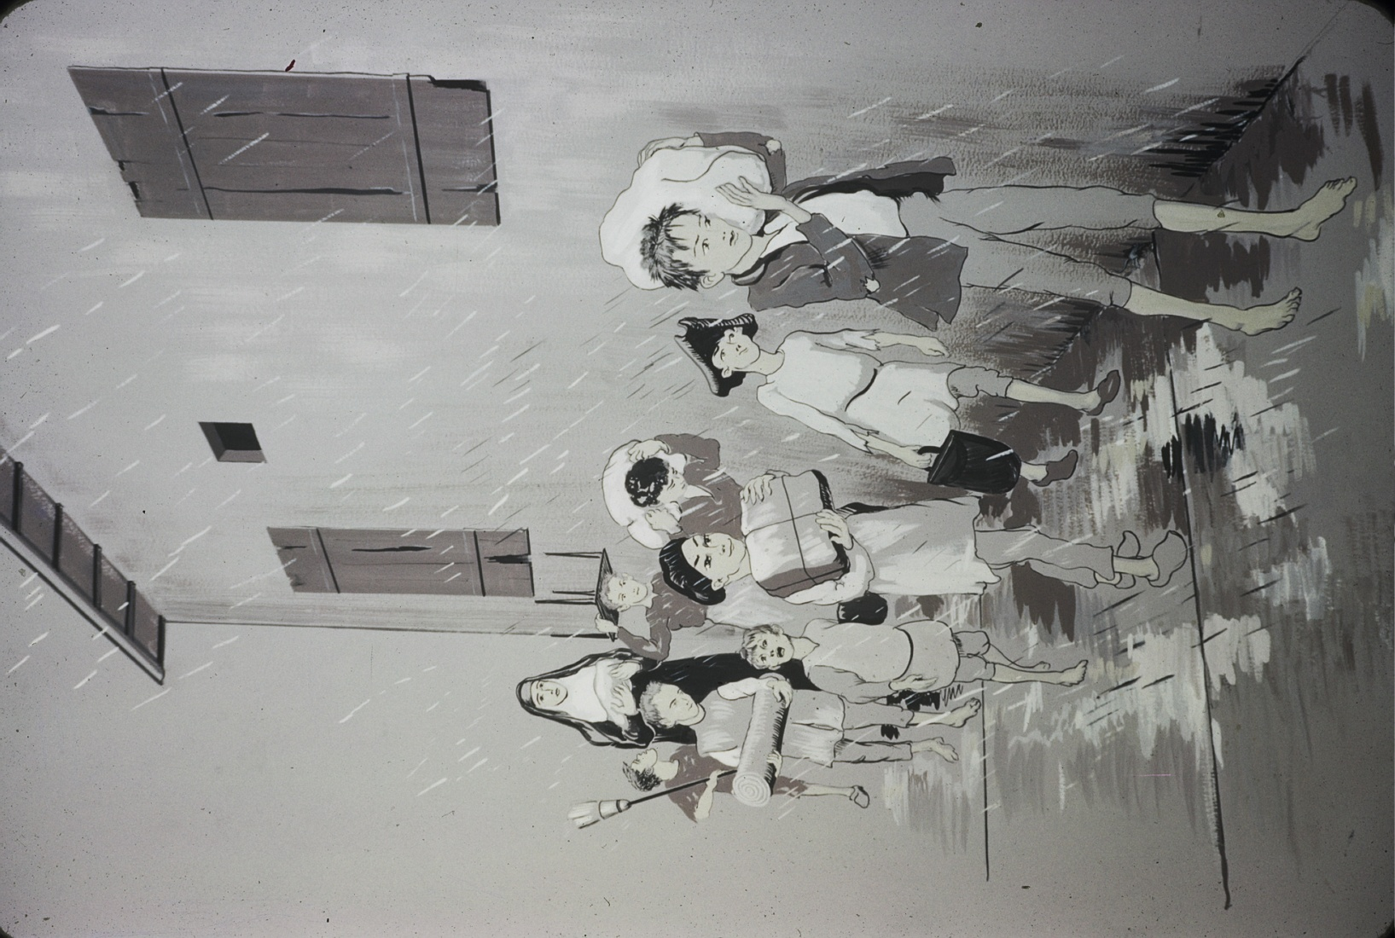
After the French Revolution ended, Philippine’s family helped her to recover the old convent on the hill which was in ruins. She found herself practically alone in this dilapidated place, cleaning, repairing, and praying.

Slide 13
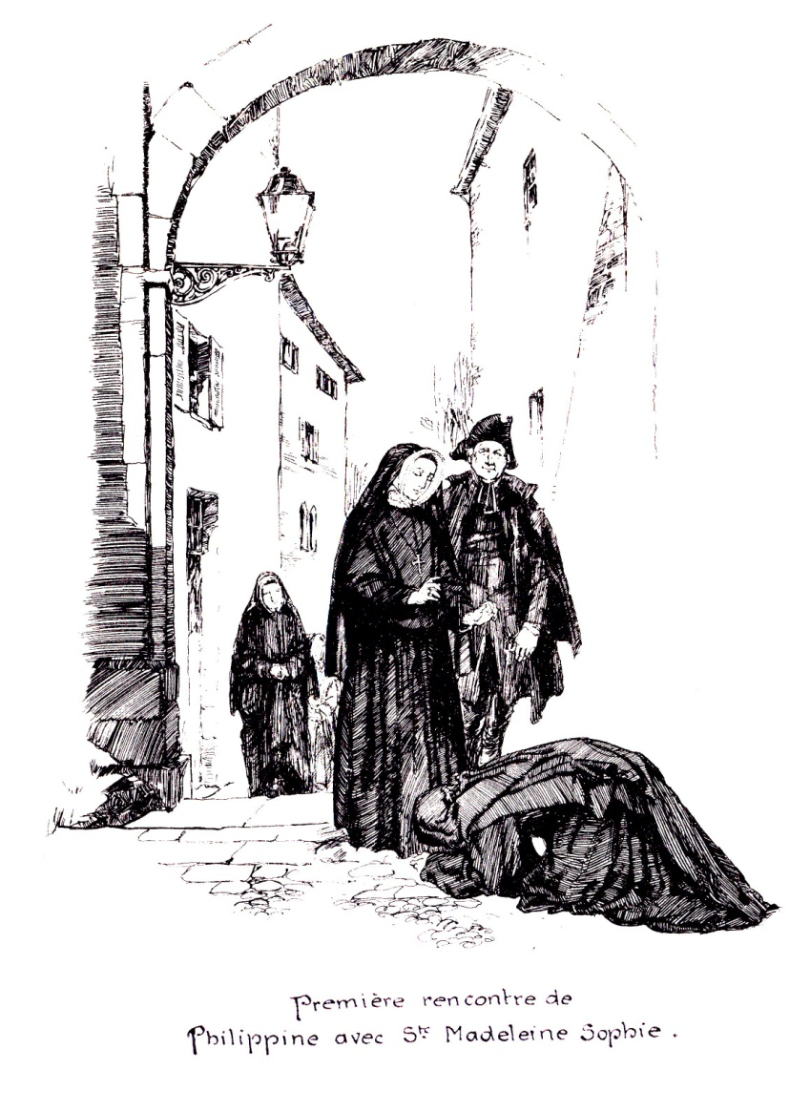
On a cold December day in 1804, new hope came into Philippine’s life. Madeleine Sophie Barat, who had recently founded the Society of the Sacred Heart, travelled 600 miles to invite Philippine to join the new religious order. “How beautiful upon the mountain are the feet of those who bring good news!” exclaimed Philippine as an expression of her profound joy.

Slide 14
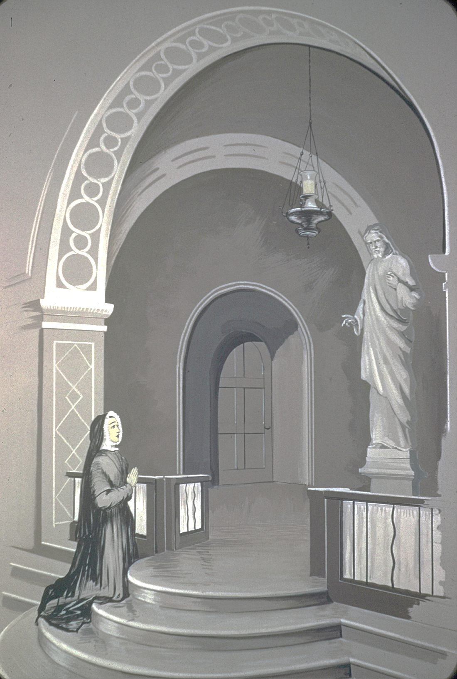
Life at Ste. Marie was happy now. Philippine was finally a member of a religious order whose purpose was to spread devotion to the Sacred Heart of Jesus and to educate girls who, as women, would carry the love of the Heart of God into the world.

Slide 15
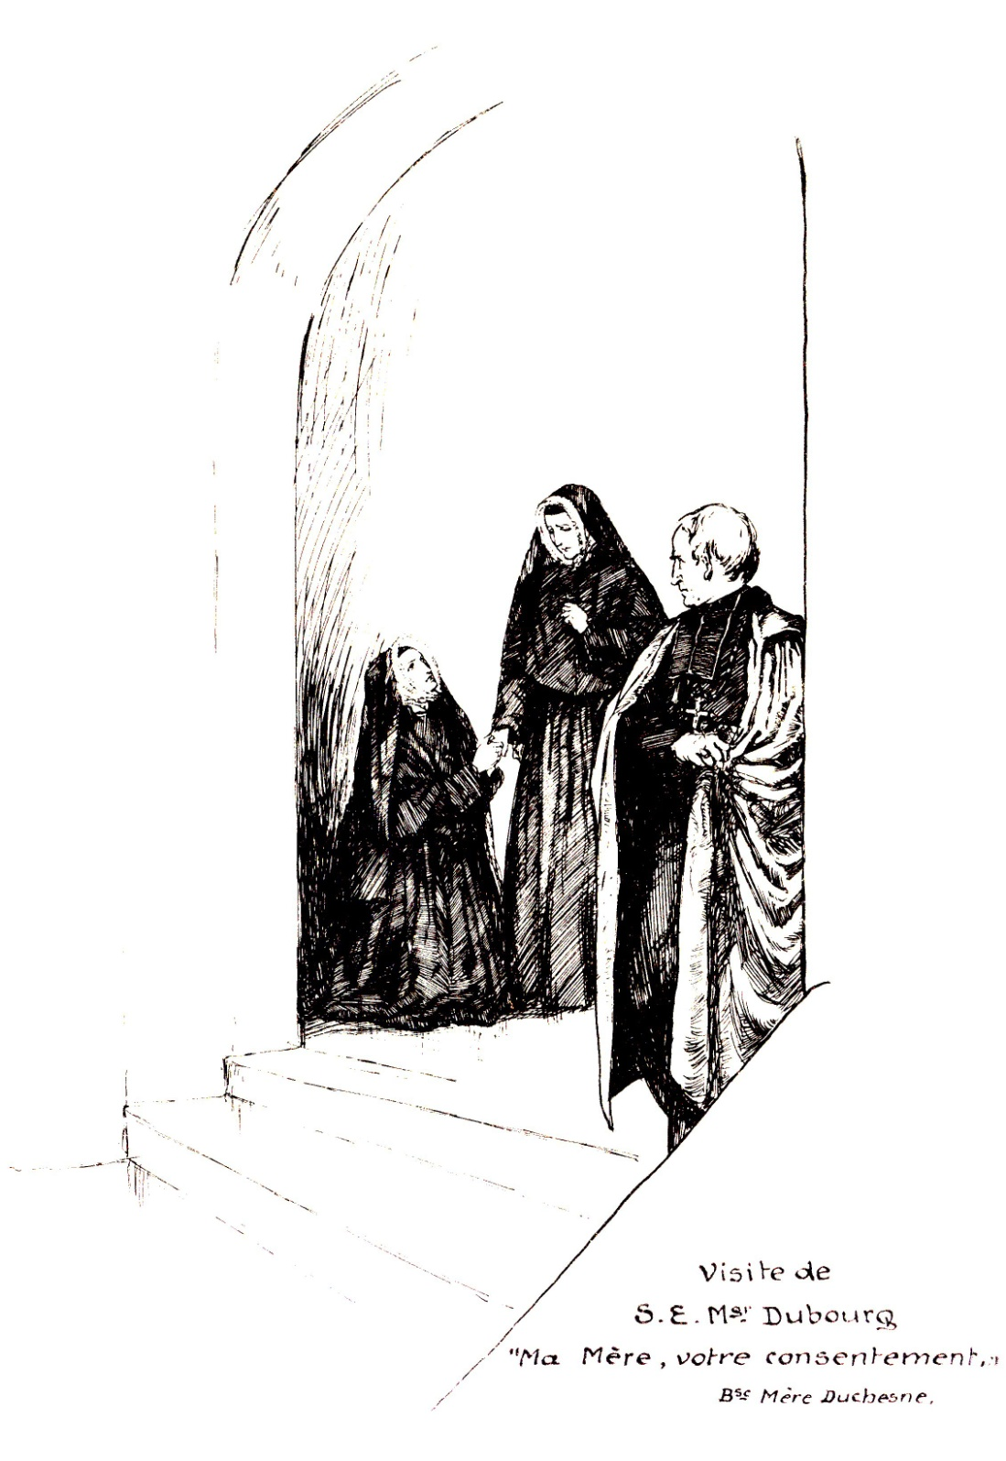
Although Philippine was content to be involved in this thriving community’s efforts, she maintained her strong desire to be a missionary to the Native Americans in the new world.
When Bishop DuBourg visited the convent in Paris in 1817, he asked Mother Barat to send Religious of the Sacred Heart to work in his American diocese. “Your consent, Mother, give your consent!” exclaimed Philippine.

Slide 16
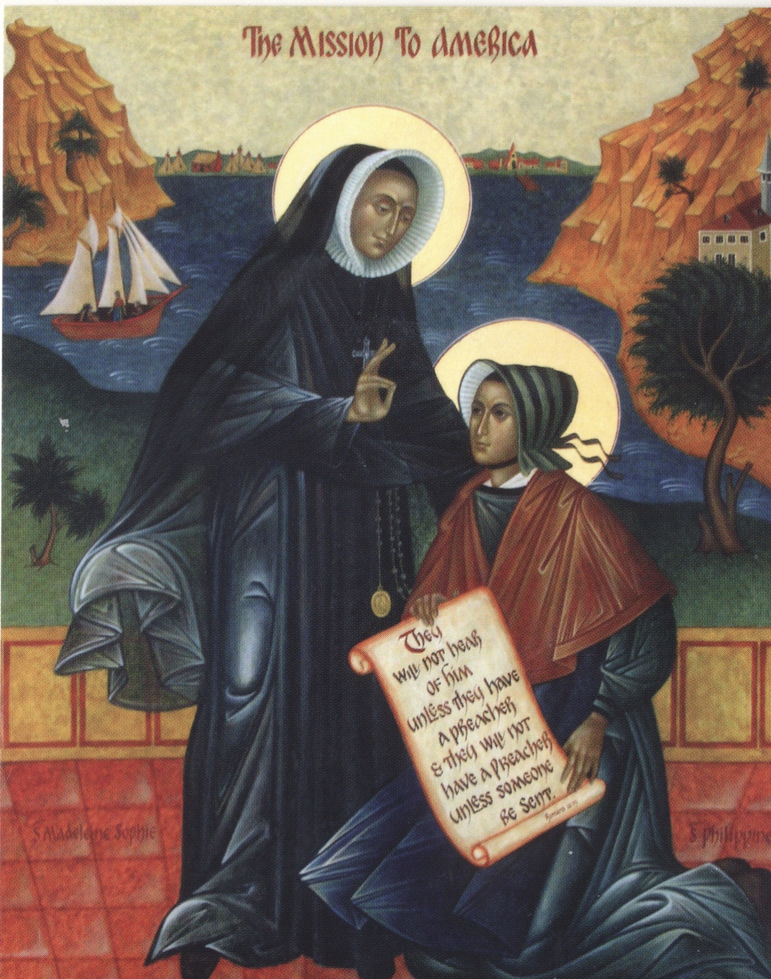
Mother Barat, realizing Philippine’s intense desire, did give her consent.
The next year was spent preparing for the journey and choosing the four religious who would be Philippine’s companions as the first missionaries of the Sacred Heart.

Slide 17
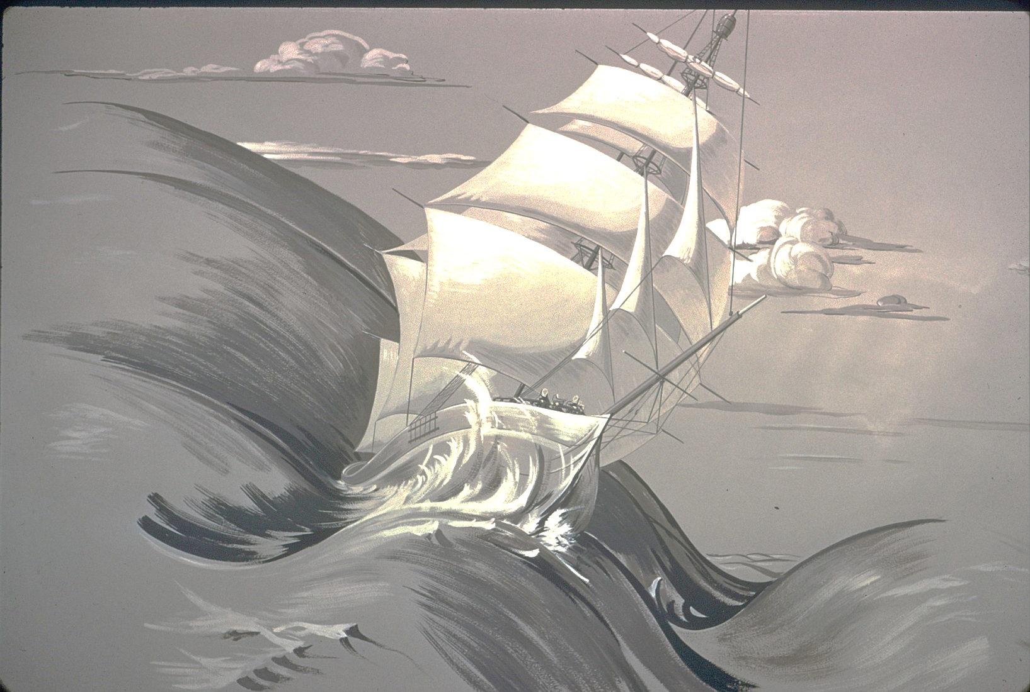
On March 21, 1818, Philippine and her companions set sail on the Rebecca to cross the Atlantic. These brave women left behind everyone and everything they knew and loved. For seventy days they endured violent storms, seasickness, spoiled food, cramped conditions that allowed for no privacy, and pirates!

Slide 18
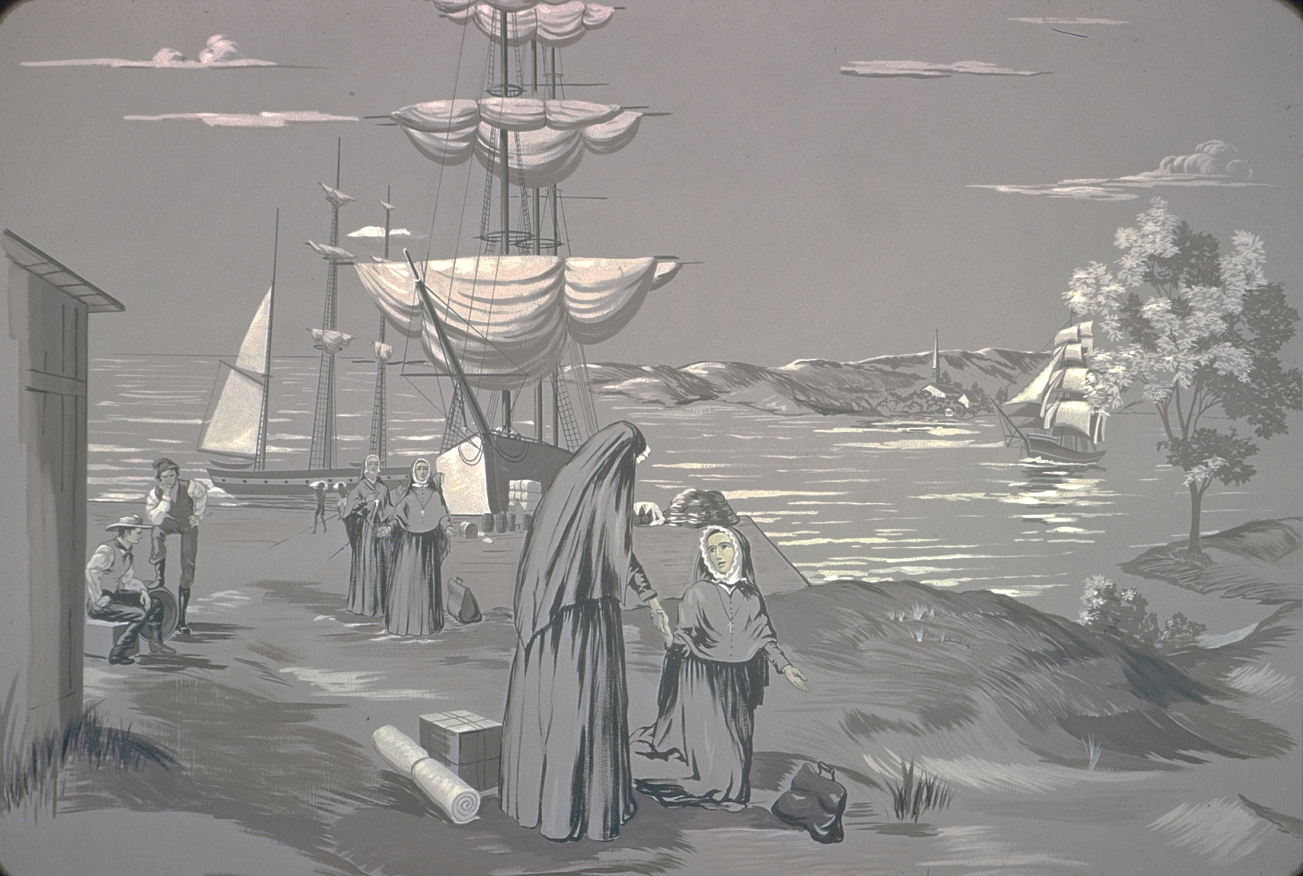
The Rebecca landed in America on the Feast of the Sacred Heart, May 29. In gratitude, Philippine knelt to kiss the ground and turned to her companions and said,
“ You do it, too. No one is looking.”

Slide 19
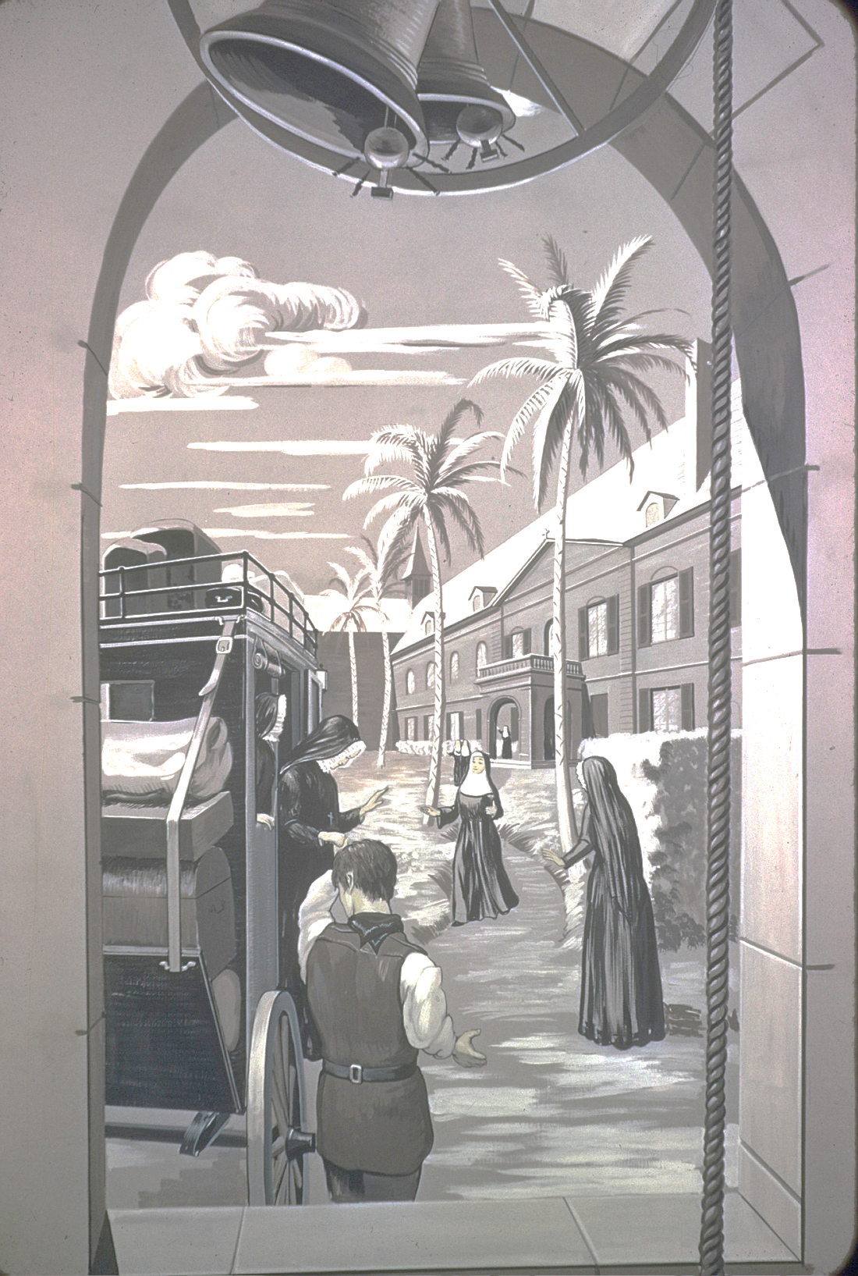
Philippine and her companions were warmly welcomed at the Ursuline convent in New Orleans, where they were showered with gracious hospitality for the next six weeks.

Slide 20
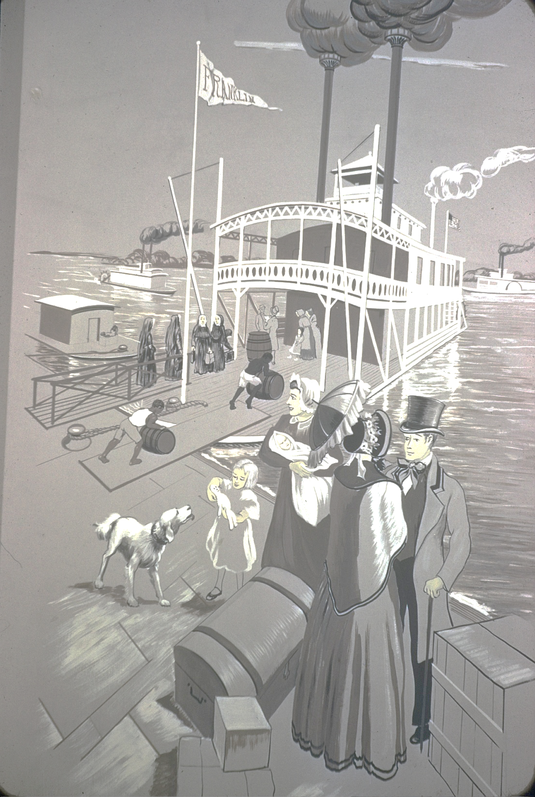
The last leg of their journey took them up the Mississippi River to St. Louis on the Franklin, a paddlewheel steamboat.
Travel on the river was treacherous: sandbars, intense heat, and swarming mosquitos were challenging to say the least!

Slide 21
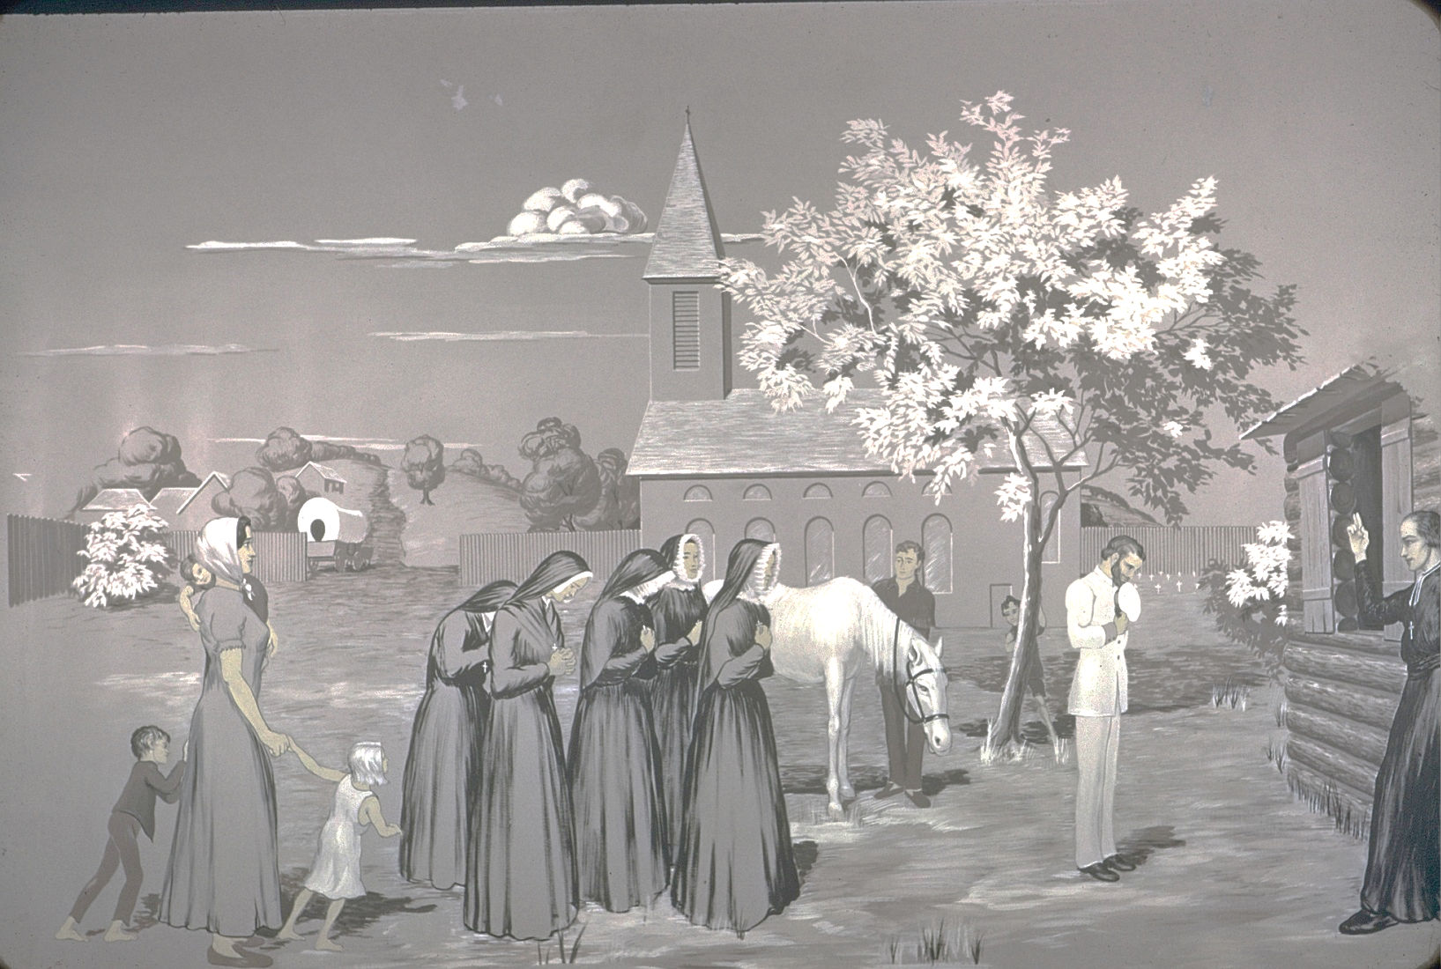
The five nuns arrived in St. Louis on August 22, 1818, only to find that Bishop DuBourg had been unable to find appropriate accommodations for them.
He surprised them with the announcement that they would travel to St. Charles, which was located on the Missouri River, about twenty miles to the west.

Slide 22
Awaiting them when they arrived on September 7, was the “Duquette Mansion,” a log cabin.
One week later, on September 14, 1818, Philippine opened the first free school west of the Mississippi in this cabin.
This was the first Academy of the Sacred Heart in the New World!
This was the beginning of Catholic education in the St. Louis Archdiocese!
This was the beginning of education in Missouri!

Slide 23
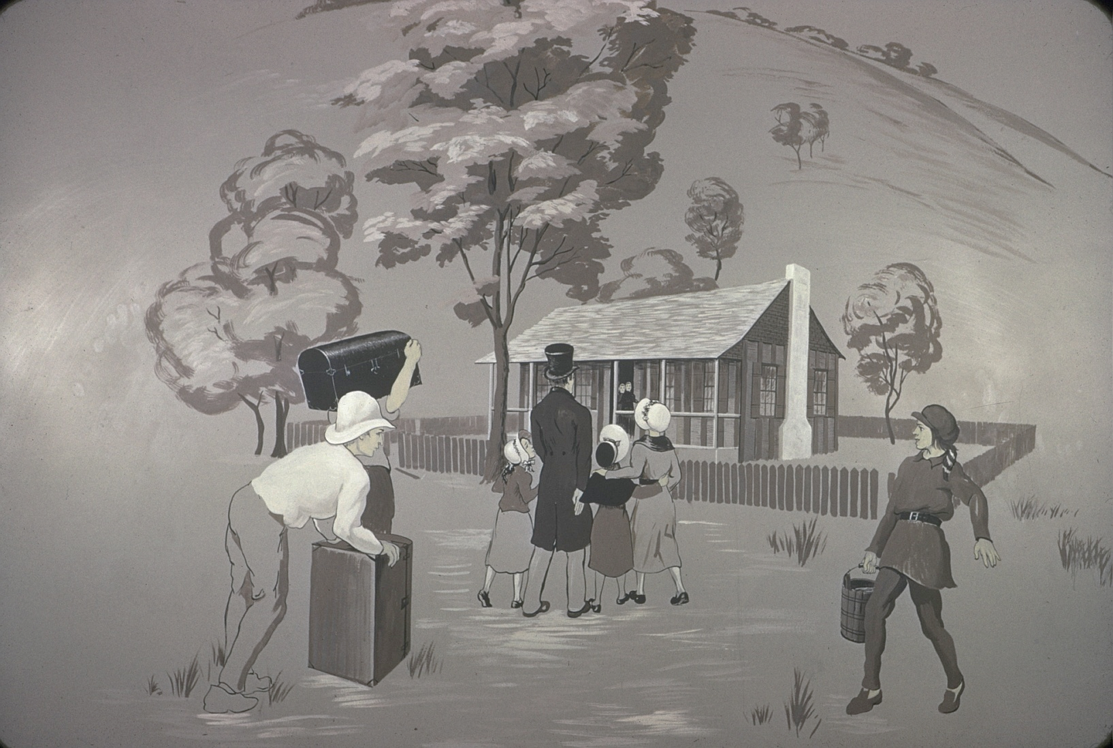
On October 3, Emilie and Therese Pratte and their cousin, Pelagie Chouteau arrived from St. Louis to board at the convent school. Because of the distance and difficulty of travel, the girls would not return home until
August, 1819.
The five nuns and three boarders slept in the one large room, which was also used as a classroom. Lack of water, shortage of food, and an intensely cold winter were some of the challenges they faced. The laundry froze inside the cabin, and Philippine wrote,
“We haven’t seen butter or eggs here for 5 months. People eat bear grease on their bread!”

Slide 24
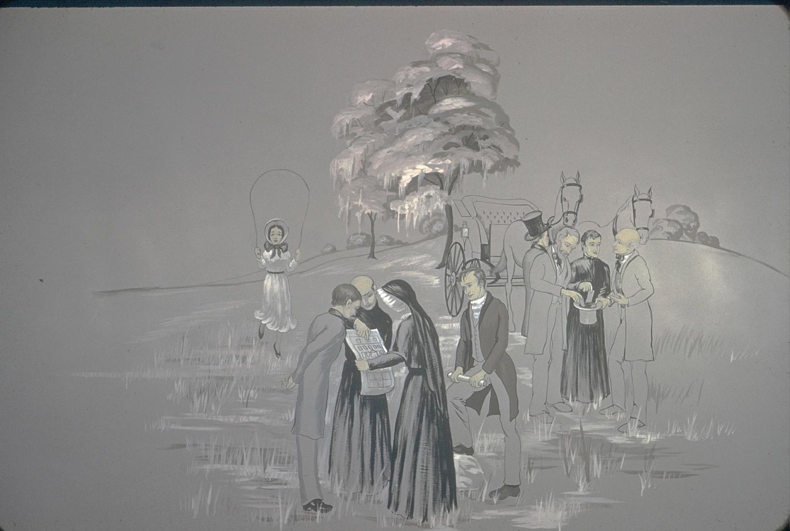
After that first difficult school year in St. Charles, Mother Duchesne asked Bishop DuBourg to move the school closer to St. Louis with the hopes of increasing the number of boarders. Plans were made to build a brick convent across the Missouri River in Florissant.

Slide 25
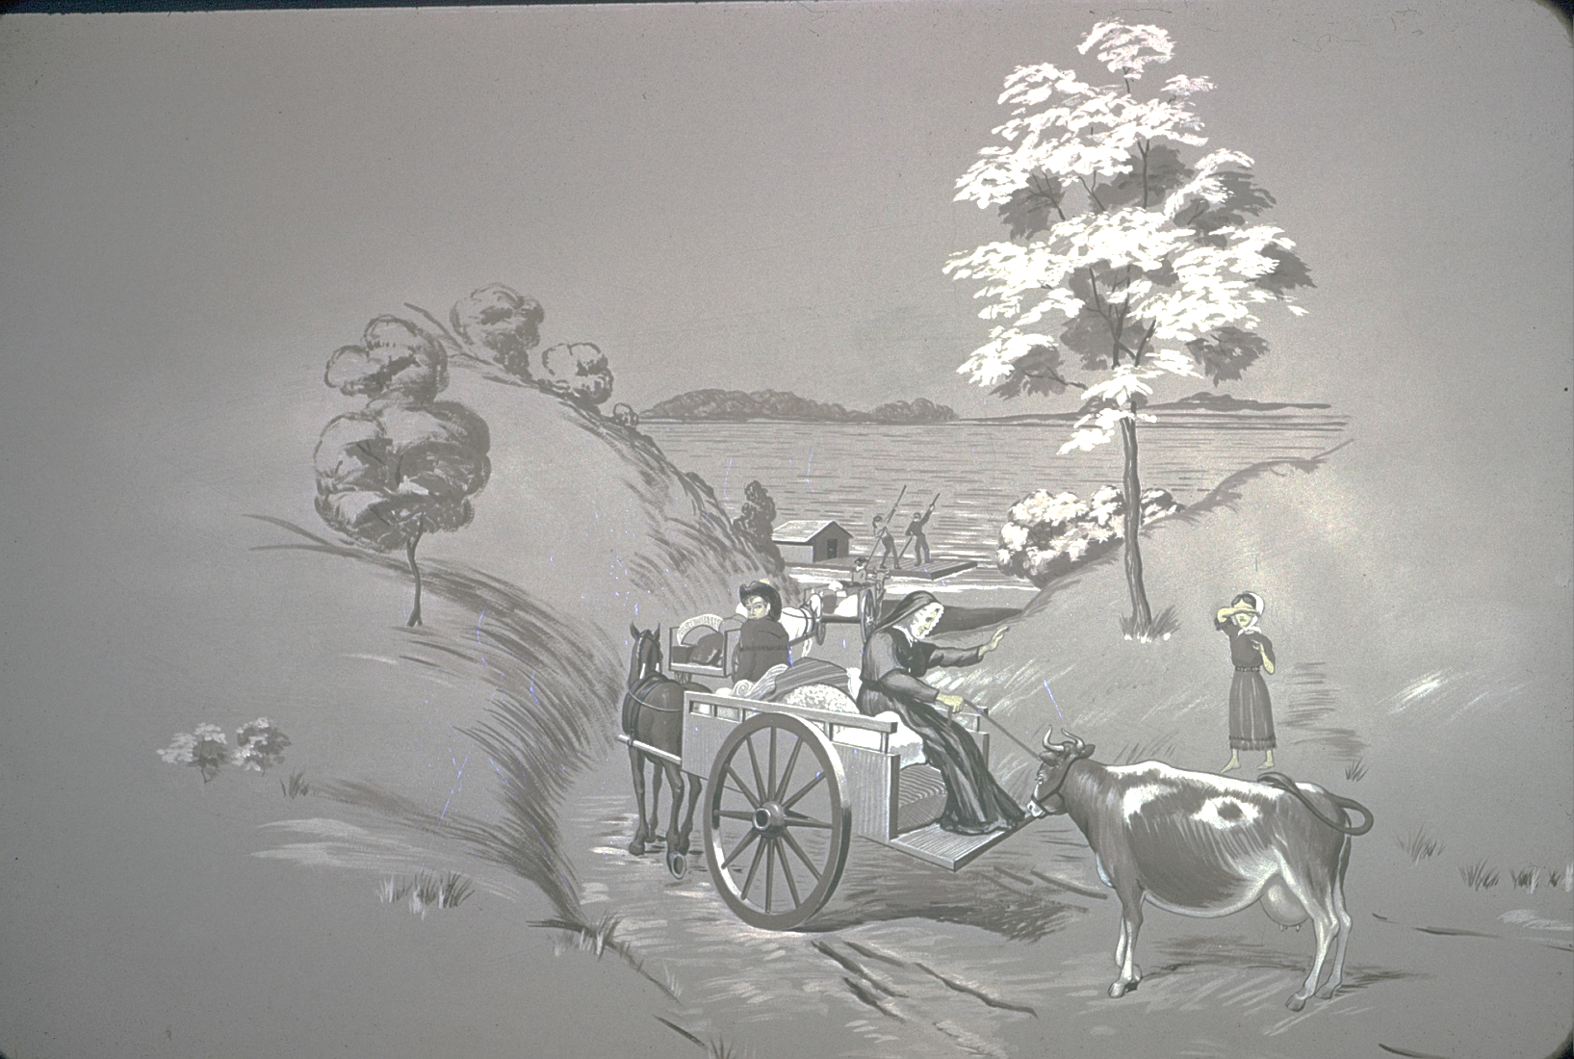
Nuns, household goods, even a precious cow were moved by ferry across the river to Florissant.

Slide 26
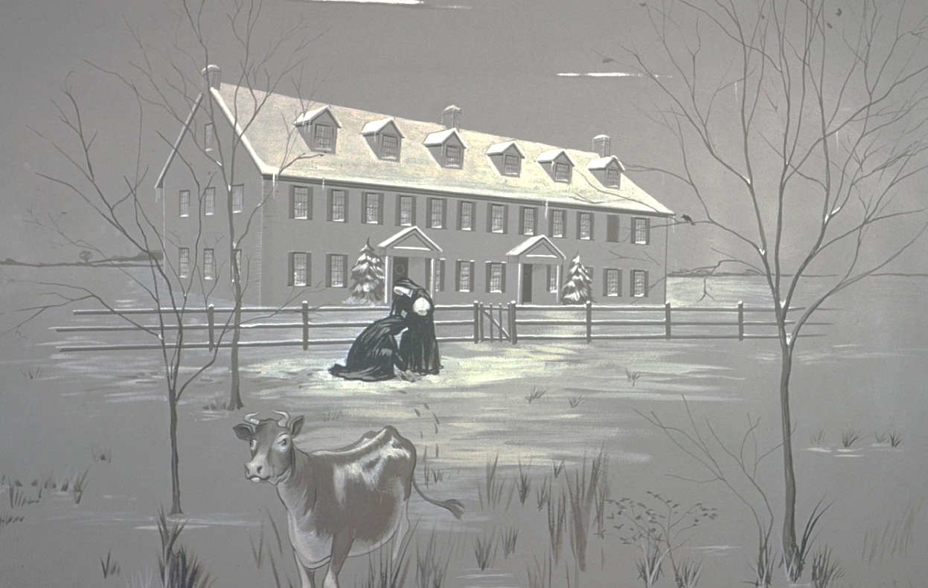
The Florissant convent, a giant step above the log cabin, was still “roughing it.” The girls loved their new school, although life on the frontier was difficult. A steady stream of young women hoping to join the order meant there would be more Religious of the Sacred Heart to do the work that was all around them.
From this humble beginning, the schools of the Sacred Heart took root in America.

Slide 27
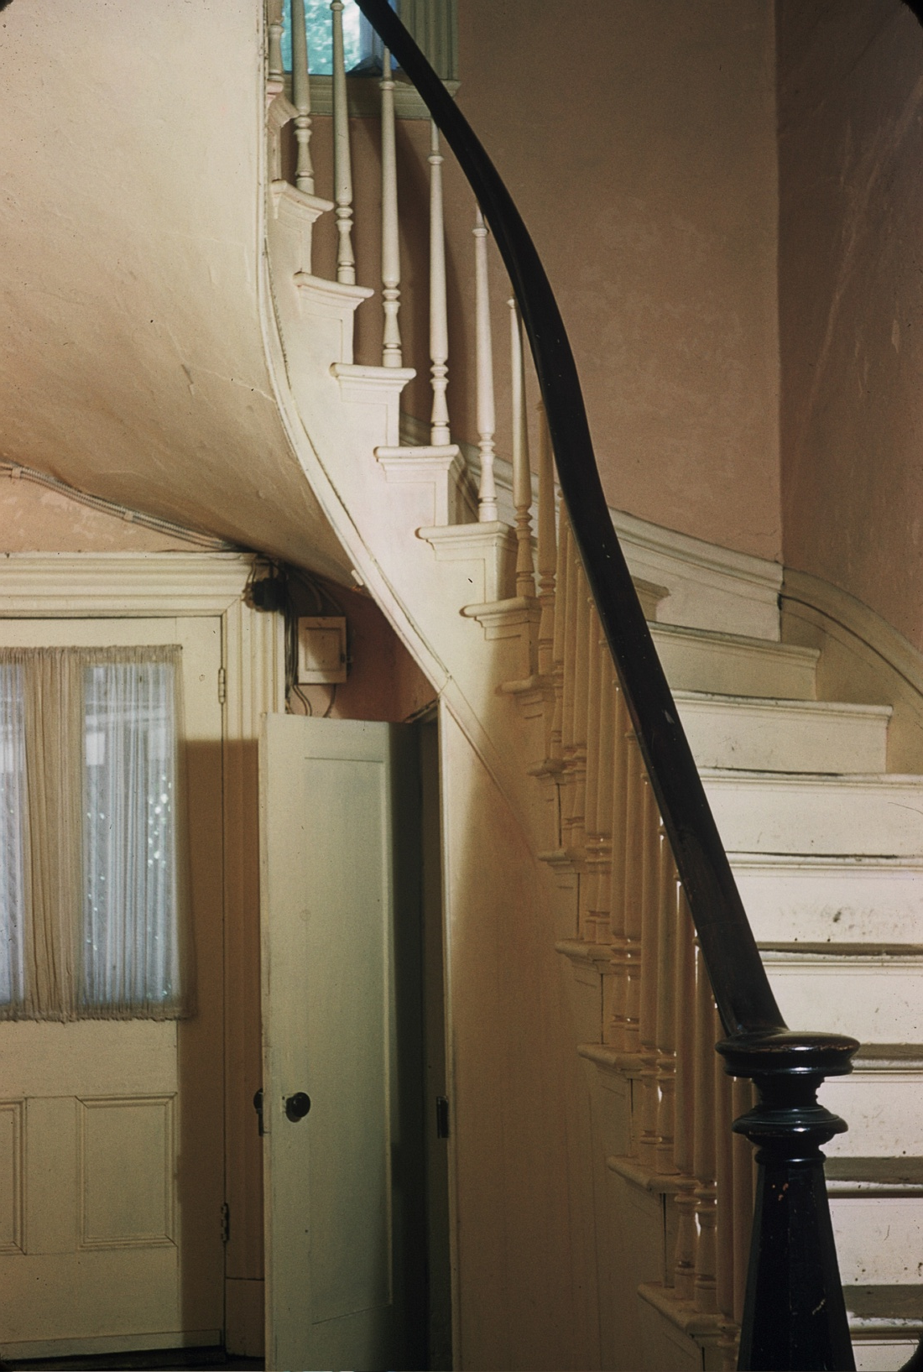
If you were to visit Florissant today, you would see Mother Duchesne’s room under the stairs. Here, or in the chapel, she would give her nights to prayer.
She spent the days cleaning, mending, and working with children. Her meals were the scraps which the children left on their plates. Her dentist was the workman who would pull out an aching tooth with his tools!

Slide 28
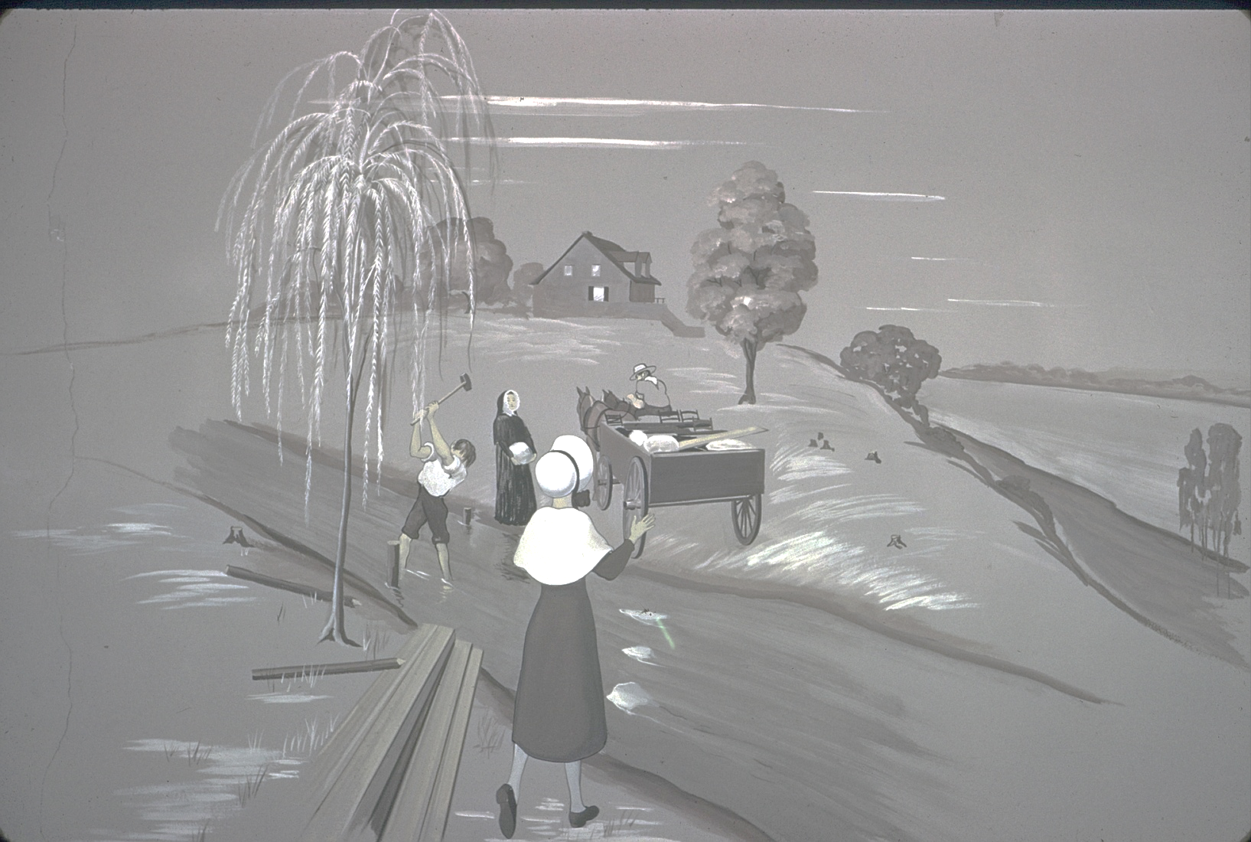
Throughout the 1820s and 1830s, the number of religious grew, and it was possible for Philippine and her religious companions to establish additional convent schools beginning with Grand Coteau, Louisiana.

Slide 29
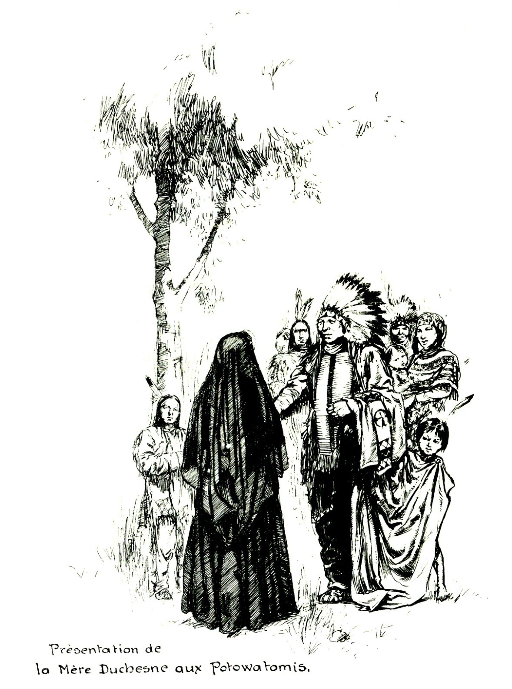
Finally, in 1841, Mother Duchesne’s dreams of going to the Native Americans came true.
Jesuit priests asked for missionaries to the Potawatomi Indians in Kansas. In spite of her advanced age, she was allowed to make this difficult trip.
Father Peter Verhaegen said, “Surely she is coming, too… she will assure success to this mission by praying for us.”

Slide 30
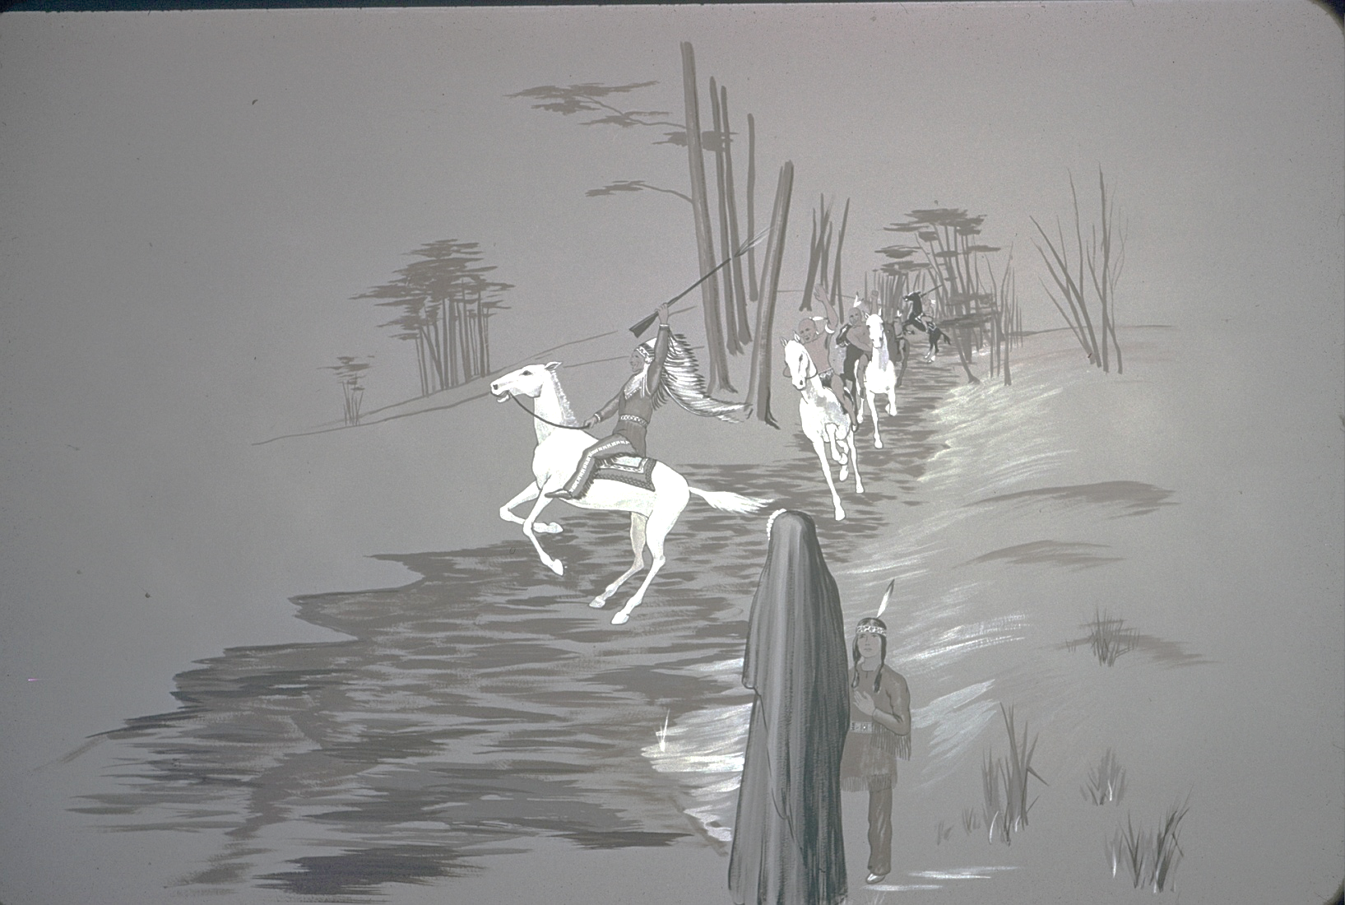
The day of their arrival in Sugar Creek was a glorious day in Philippine’s life. The parade of braves performing exercises on horseback certainly conveyed the welcome that made her 72 years of waiting worthwhile.
“We have reached the country of our desires!” wrote Philippine.

Slide 31
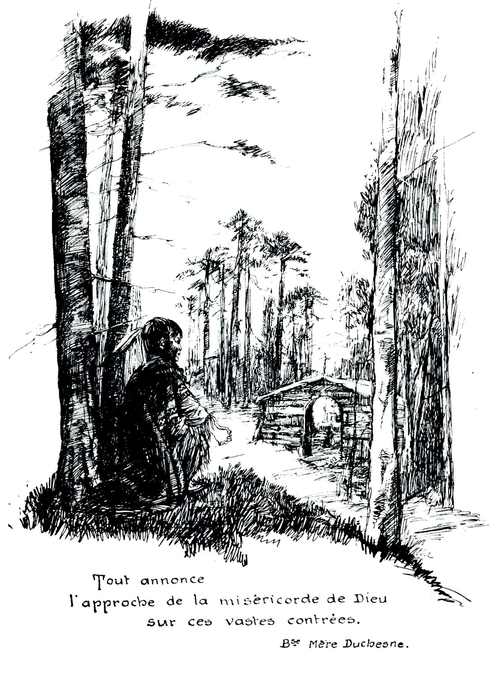
The Native Americans’ experience with Philippine was based on what they saw, a figure of pure holiness.
They brought the “good old lady” fresh corn, newly laid eggs, chickens, and wild sweet plums as tokens of their admiration.

Slide 32
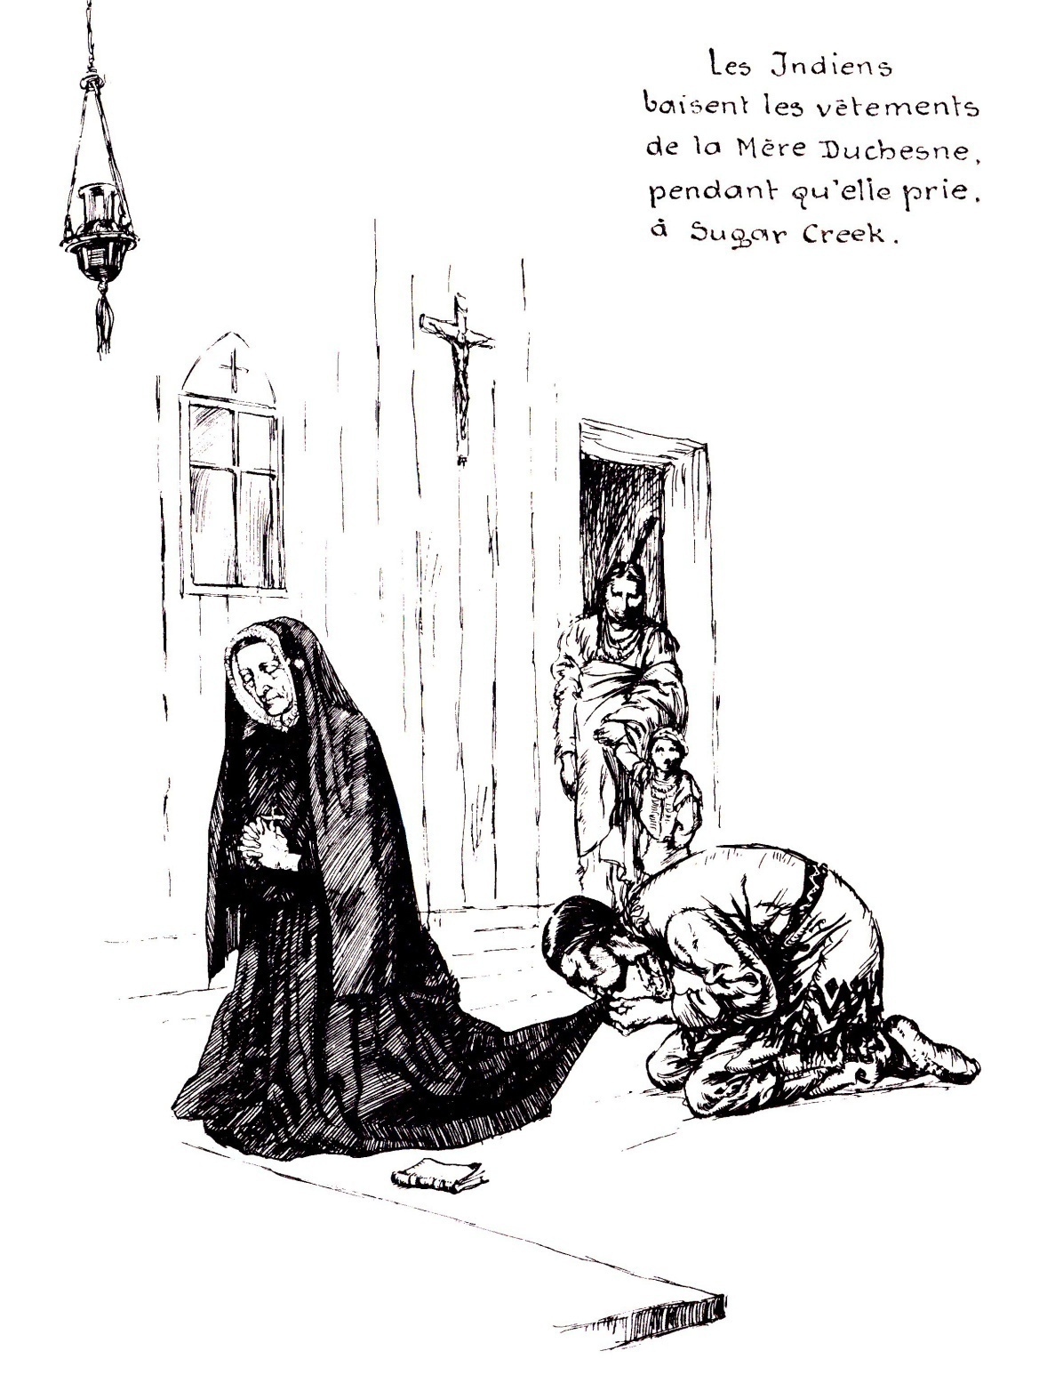
She spent countless hours of prayer in the little log chapel.
As she knelt there motionless, the Indians noiselessly approached her and kissed the hem of her worn habit.
“Qua-kah-ka-num-ad” they would call her…
“Woman Who Prays Always.”

Slide 33
After just one year among her beloved Potawatomi, Philippine and Father Verhaegen made the difficult journey back to St. Charles, where she lived for ten more years.

Slide 34
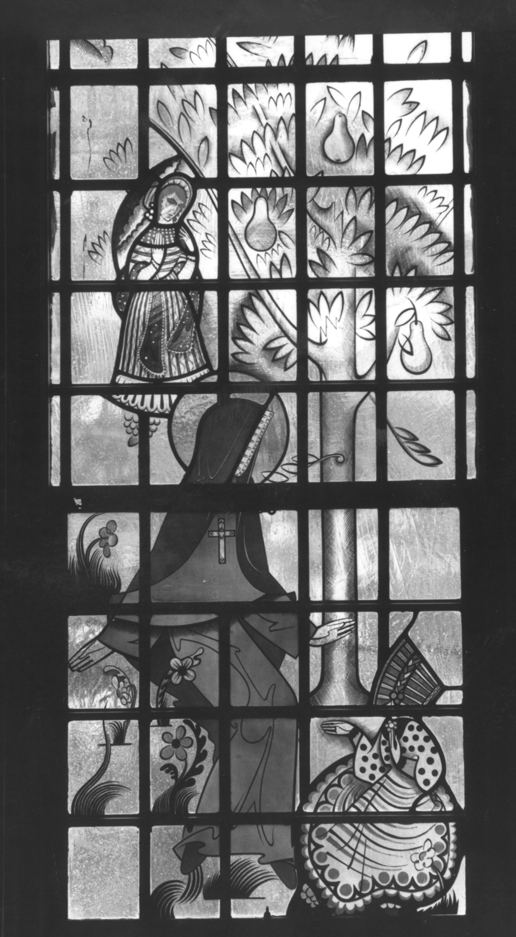
The nuns gave her tasks that made her feel useful. She taught catechism to children and especially liked to sit under a beautiful pear tree and pray.
Often she was seen there crying, perhaps feeling she had failed in her mission.
Father Peter DeSmet, S.J., who had been Philippine’s friend for many years said, “She has sewn deep roots in American soil, and someday they will reap an abundant harvest.”

Slide 35
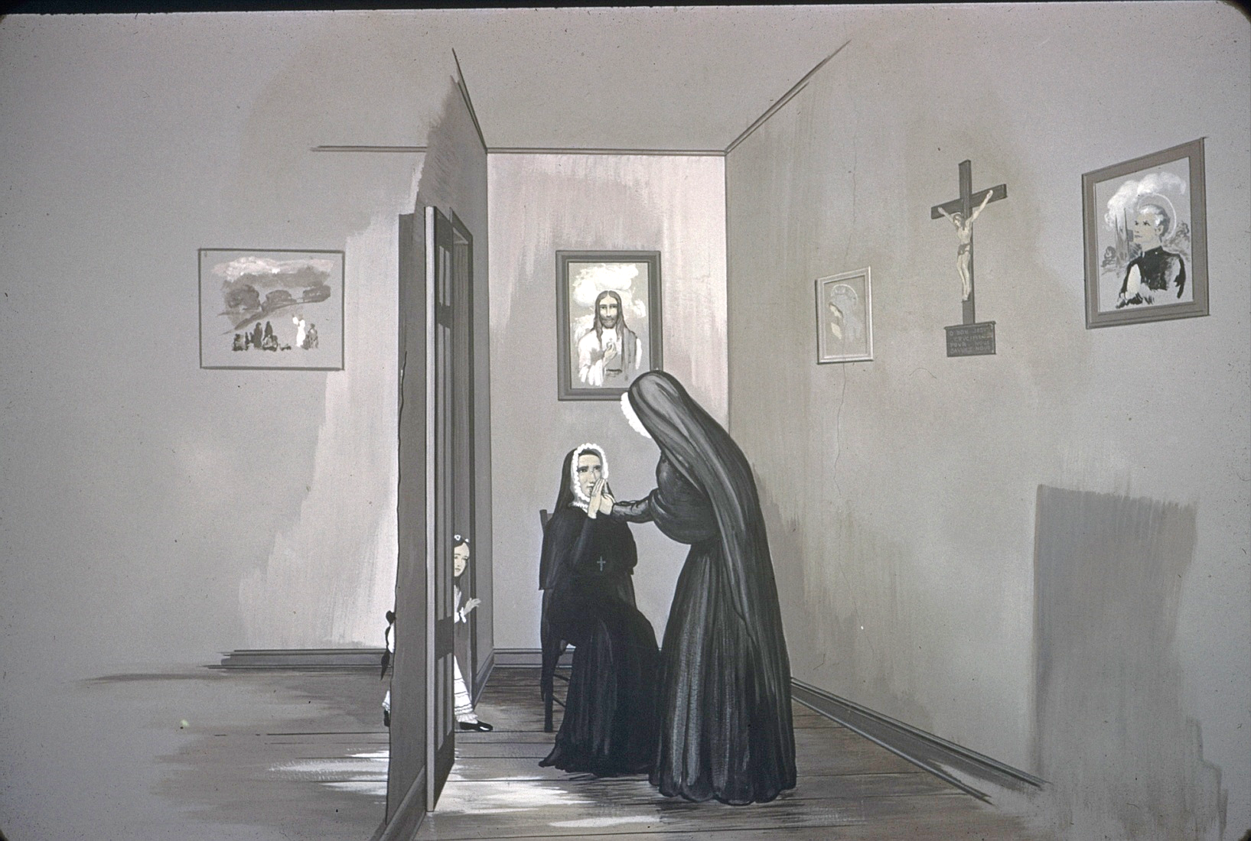
For the last ten years of her life, much of her day was spent in prayer in her little room close to the St. Charles convent chapel.
Two days before her death, Philippine had an important visitor, Anna du Rousier, who was especially sent to deliver a blessing from Mother Barat. In return, Mother du Rousier asked for Philippine’s blessing on her mission to establish a school in South America. The elderly Philippine traced a cross on the young nun’s forehead, and for years afterward, Anna du Rousier said,
“I still seem to feel that cross.”

Slide 36
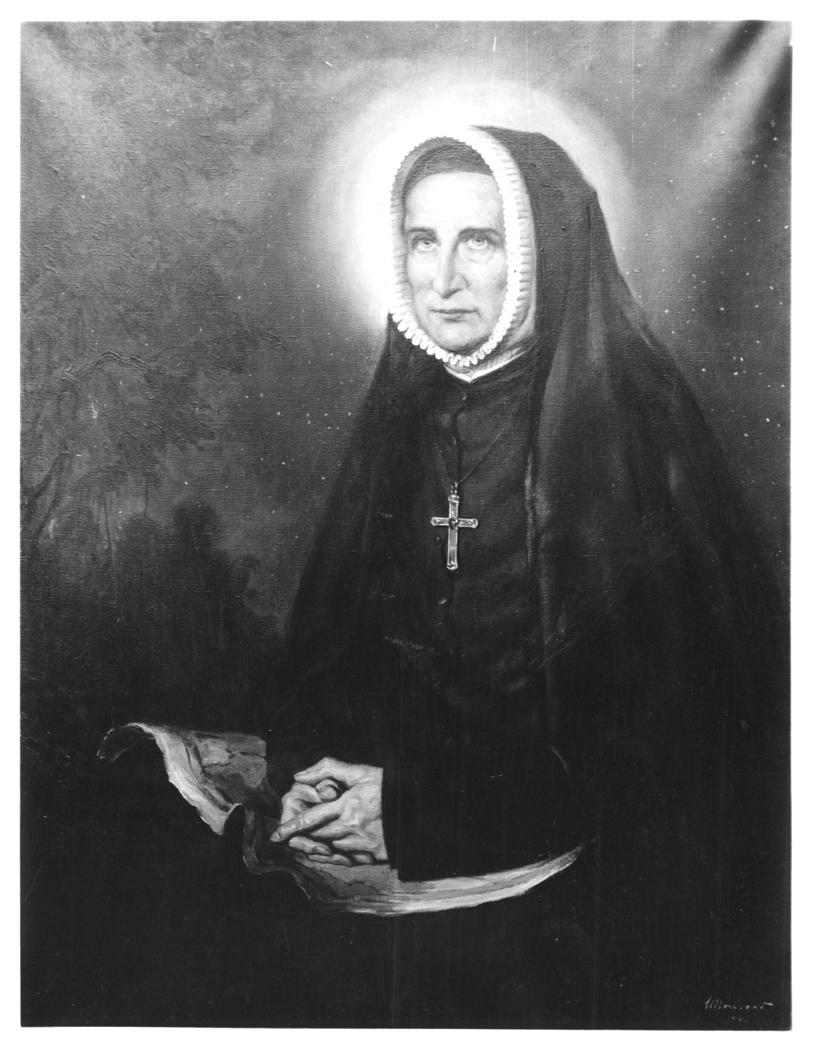
After waiting to be with her God for so long, on November 18, 1852, she said, “I give you my heart, my soul, and my life – oh, yes – my life generously.” At noon, she died.
Father Verhaegen, her long time friend wrote,
“Madame Duchesne was a native of France and came to the United States of America with a small number of Religious of the Sacred Heart in 1818. She may be considered the foundress of all the houses of the Sacred Heart in the United States. Eminent in all virtues of religious life, but especially in humility, she sweetly and calmly departed this life in the odor of sanctity on the 18th day of November, 1852.”

Slide 37
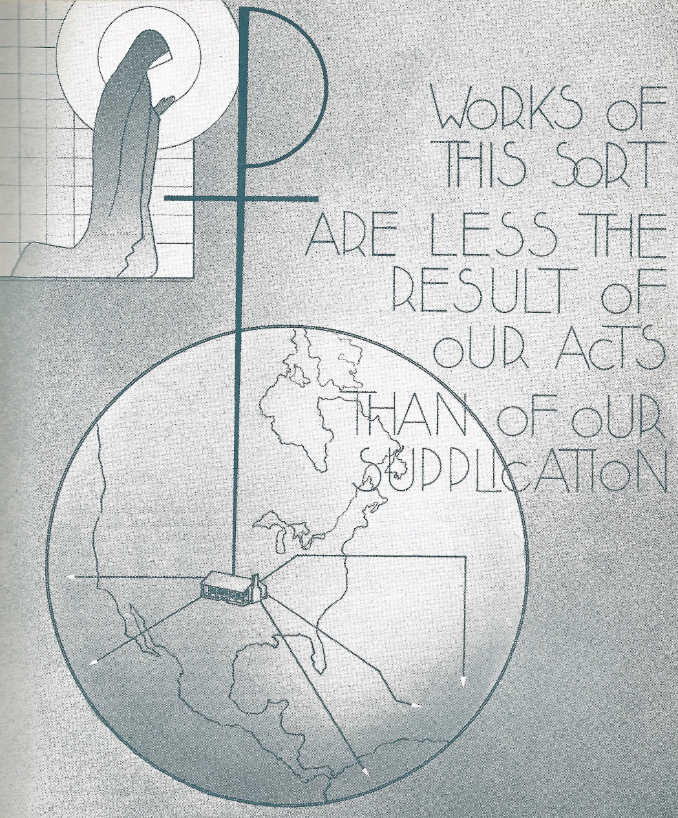
In the years following Philippine’s death, more Schools of the Sacred Heart were opened in North and South America, Africa, Oceania, and Asia.
Missionaries, inspired by the first religious to venture to the American frontier, shared the love of Jesus with students throughout the world.
Even today, Philippine continues to inspire young and old alike.

Slide 38
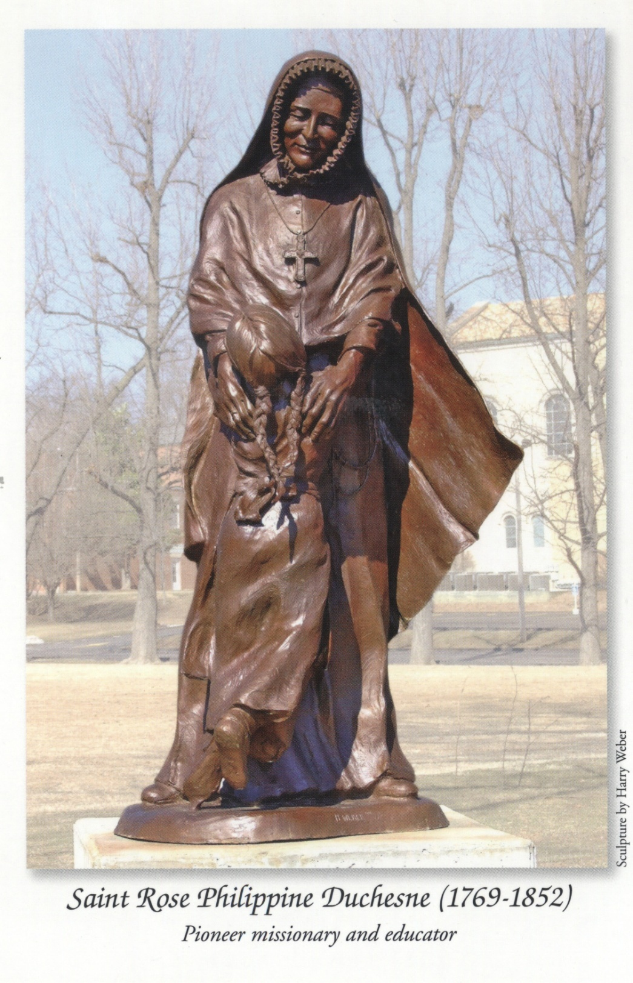
What have we learned from our
St. Rose Philippine Duchesne?
We admire and strive to imitate:
her intense love of God
her selflessness
her courage
her obedience
her humility.

Slide 39
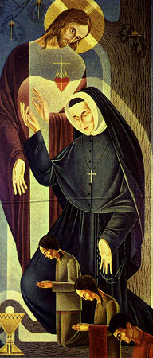
On July 3, 1988,
Pope John Paul ll declared
Rose Philippine Duchesne
a saint of the Roman Catholic Church.
Clearly, she was not a failure!

Slide 40
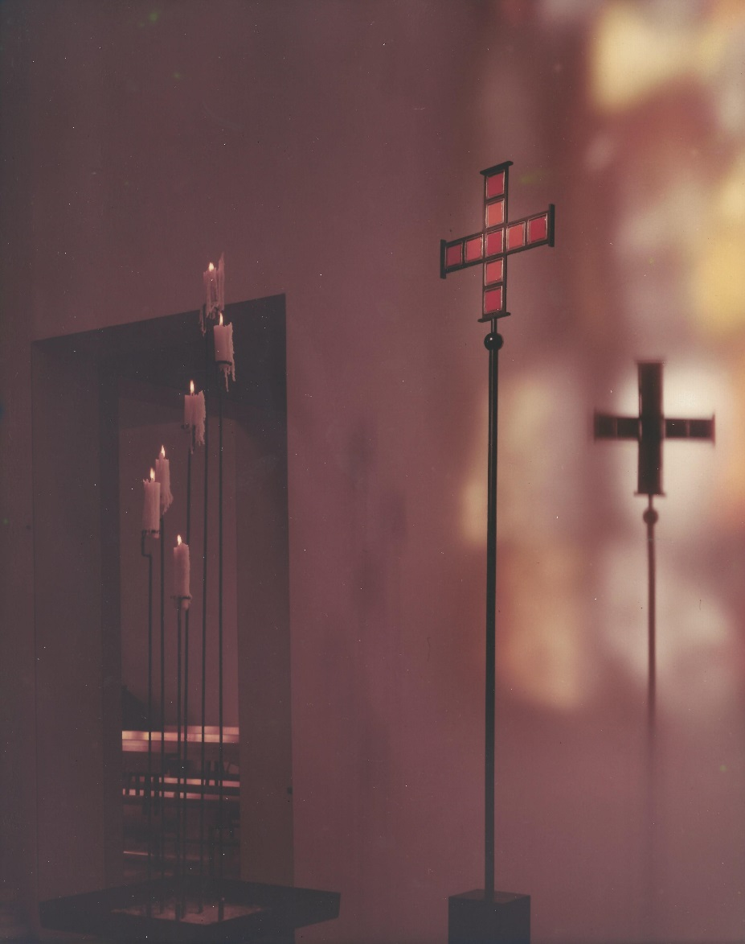
The text was adapted by Kathleen Hopper and Theresa Grass
from a script written by Jane Cannon.

